Slide 1


Slide 2
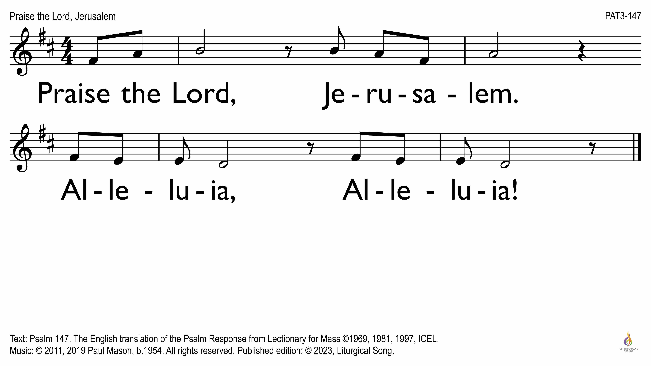

Slide 3
Introductions
Composers
  Fiona Dyball
  Roger Heagney
  Paul Mason
  Anne Millard
Booth Sales
  Julie Moran
Performers
  Fiona Dyball, Soprano
  Cath Mahony, Soprano
  Paul Mason, Piano, Tenor
  Anne Field, Alto
  Toloa Mataele, Baritone
  Daniel Nguyen, Flute
  Tammy Stone, Soprano
  Damian Whelan, Piano and Organ

Slide 4
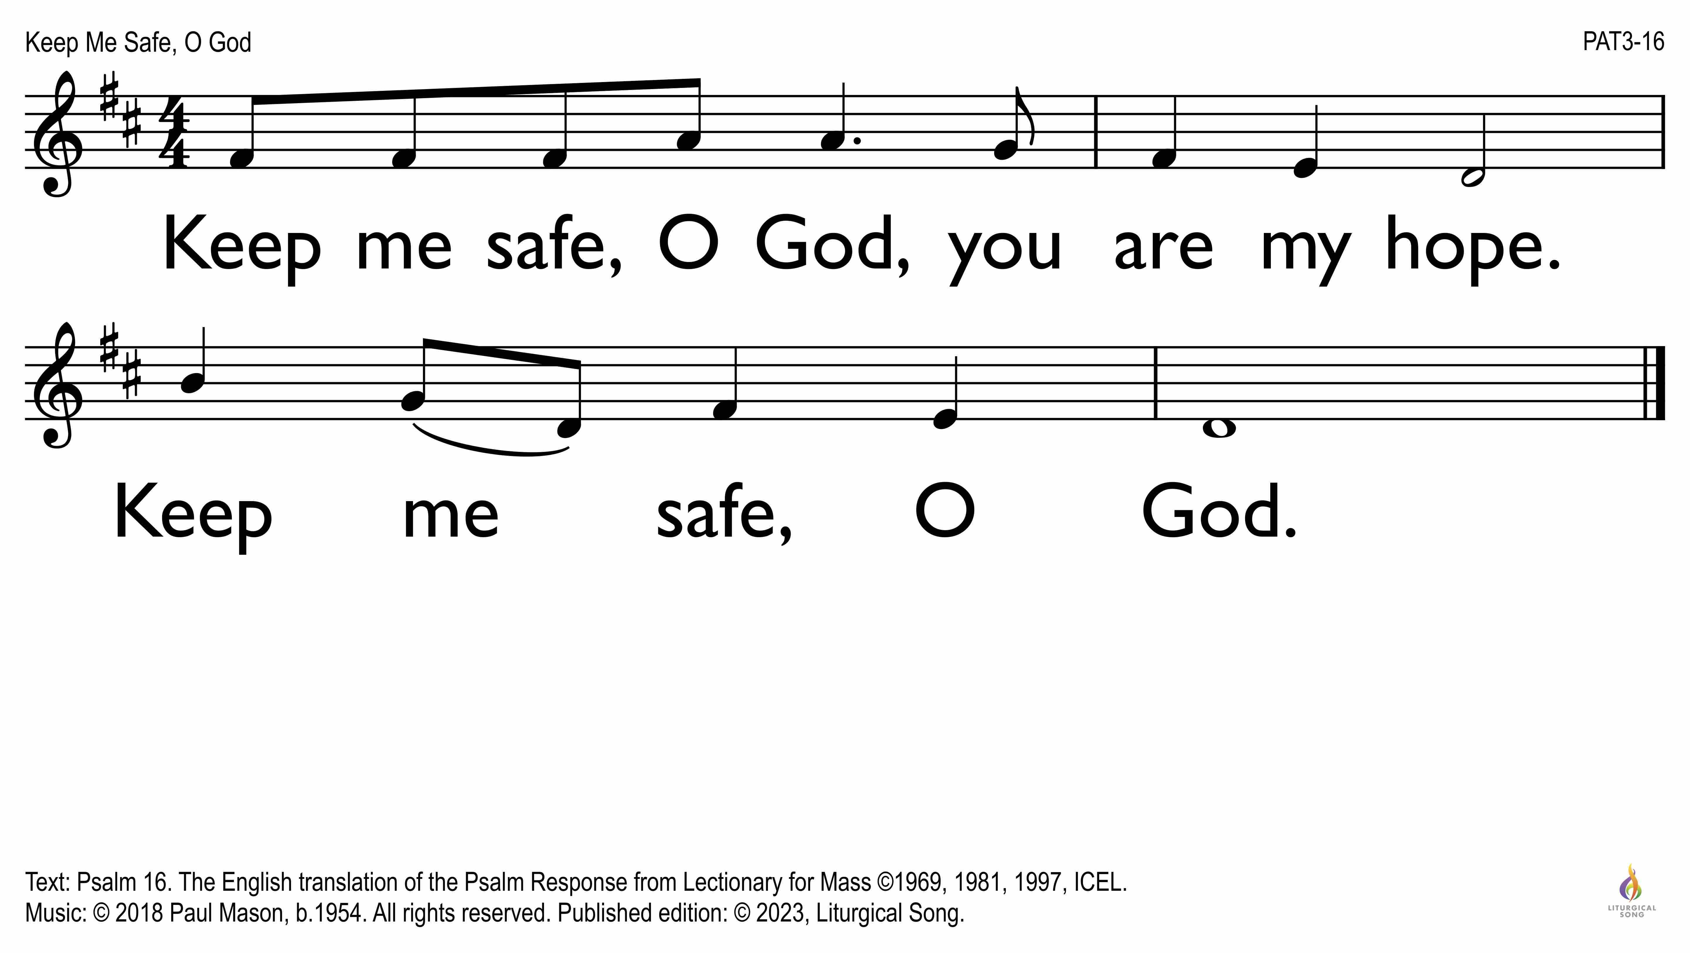

Slide 5
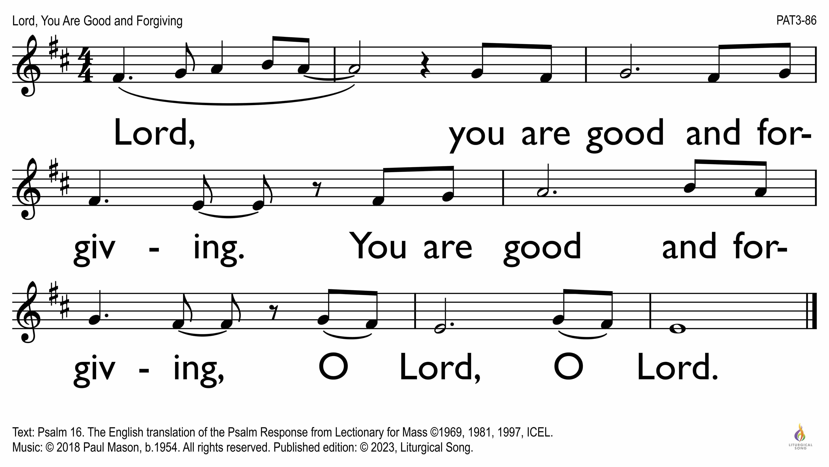

Slide 6
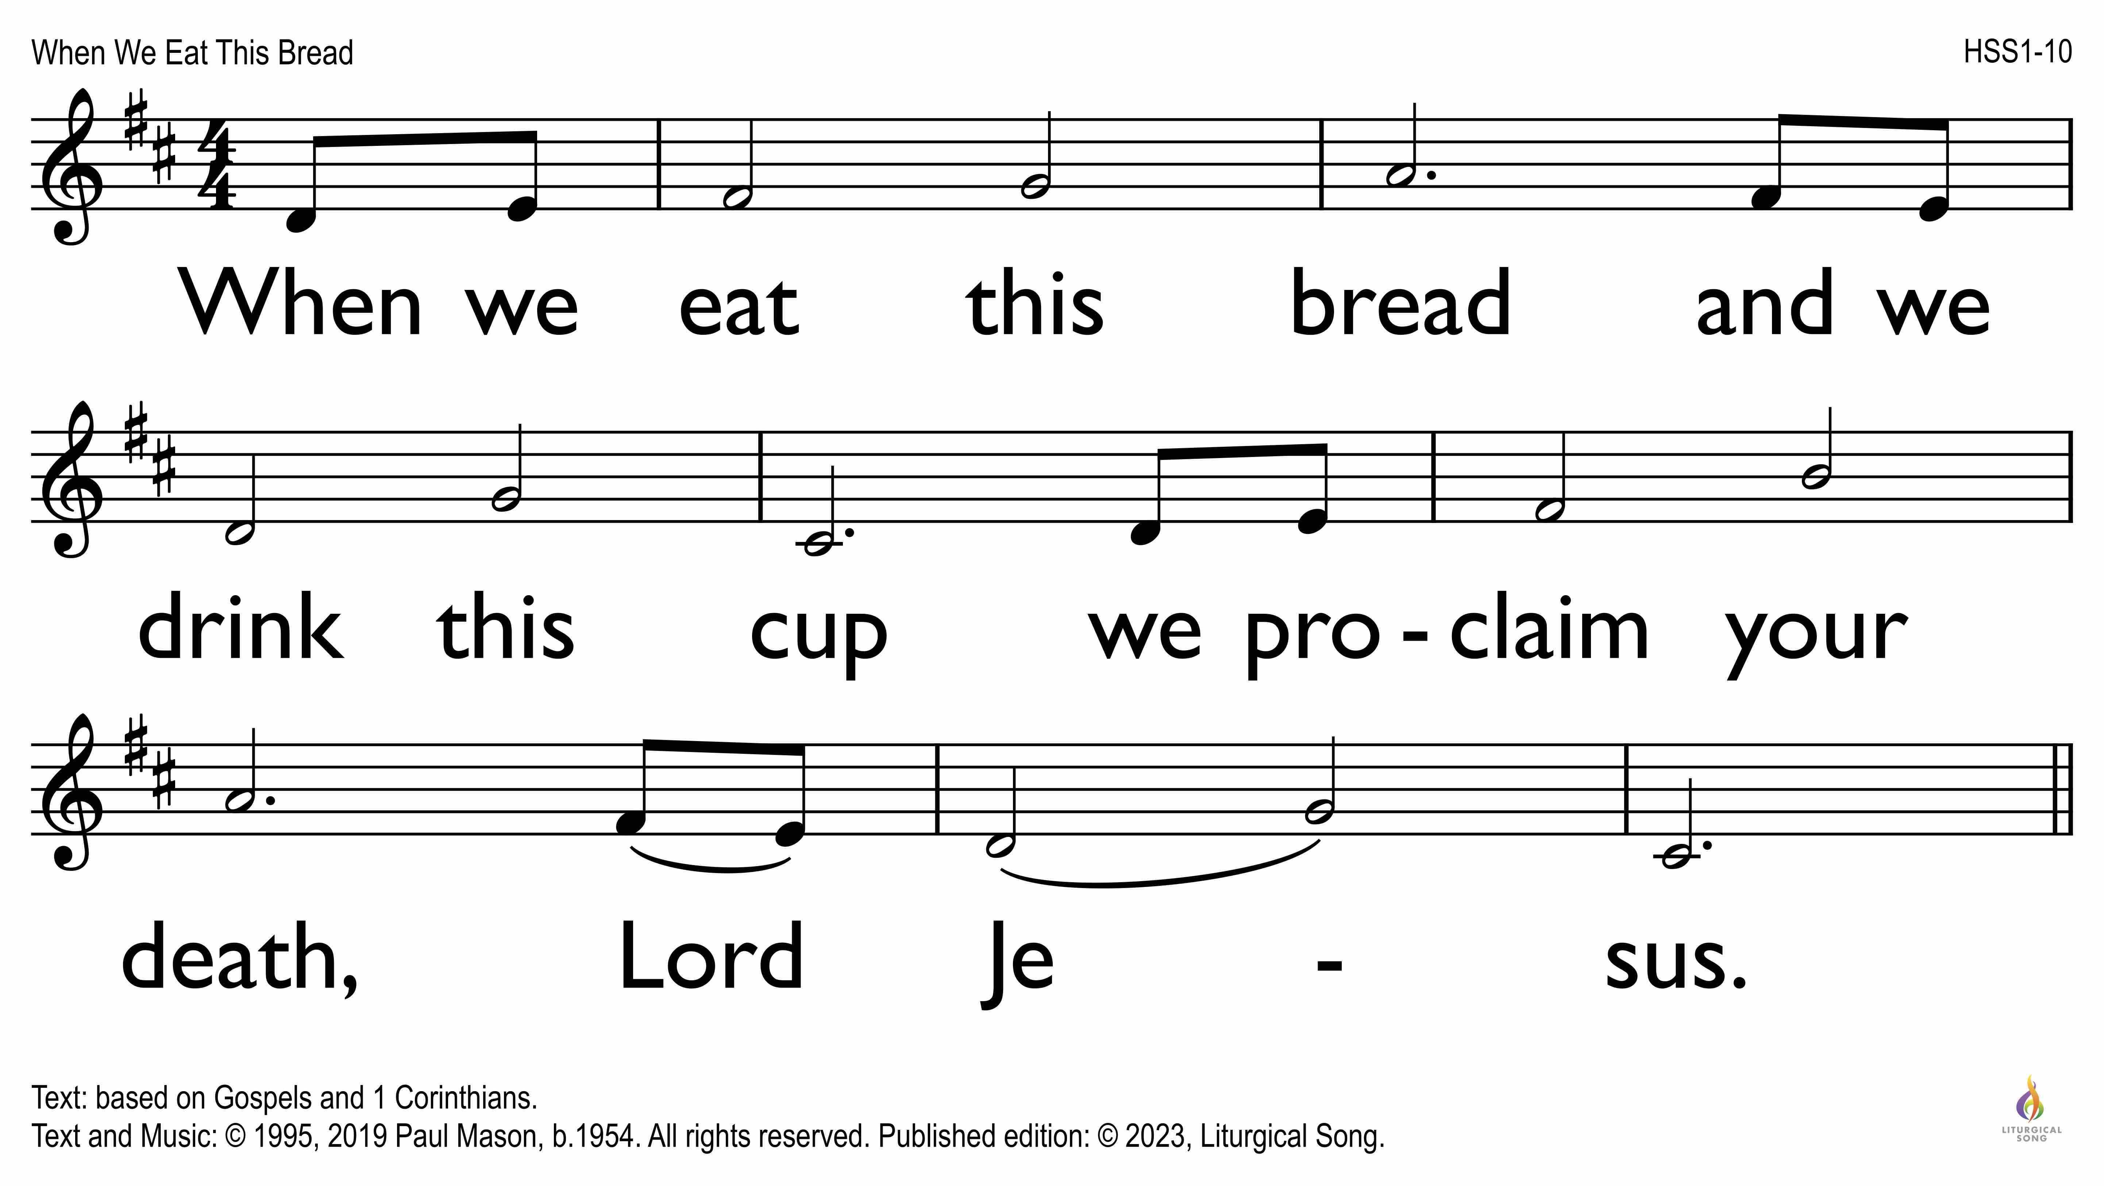

Slide 7
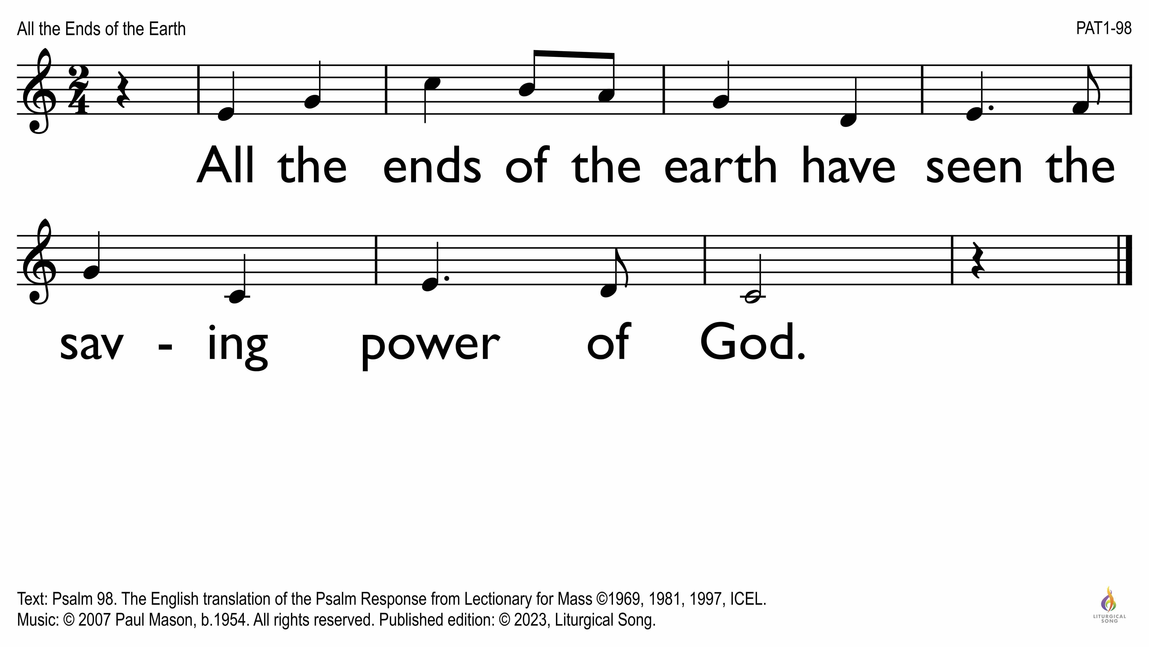

Slide 8
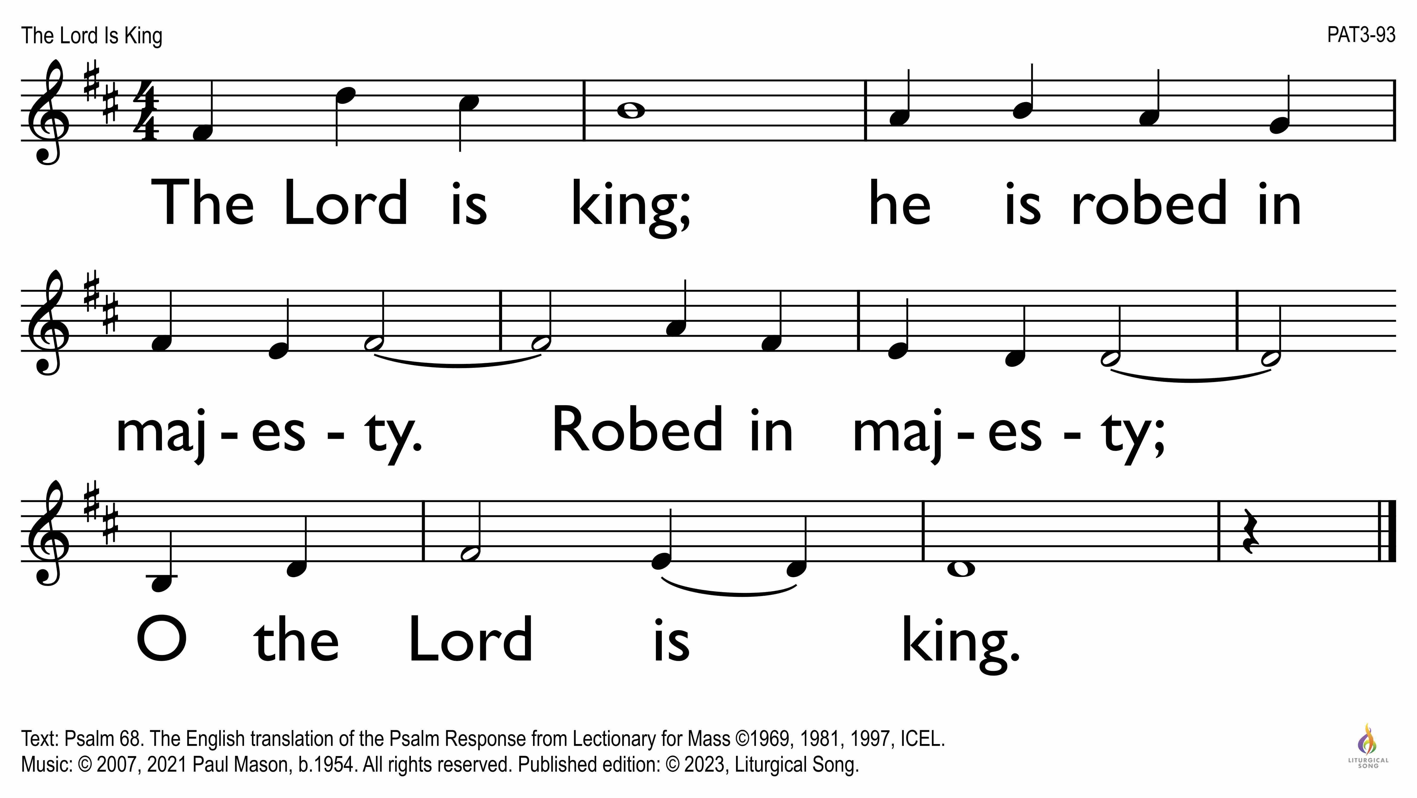

Slide 9
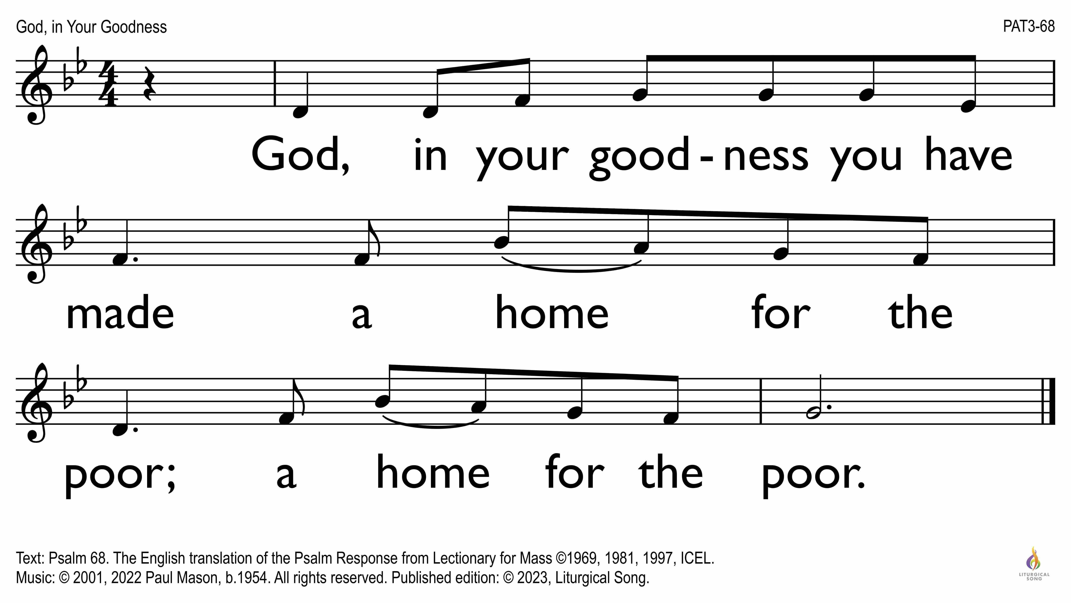

Slide 10
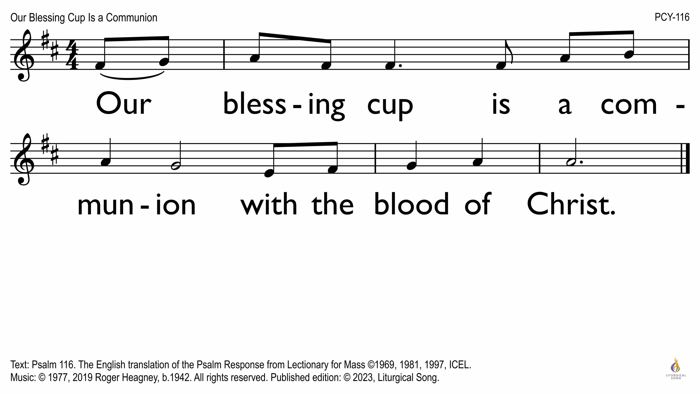

Slide 11
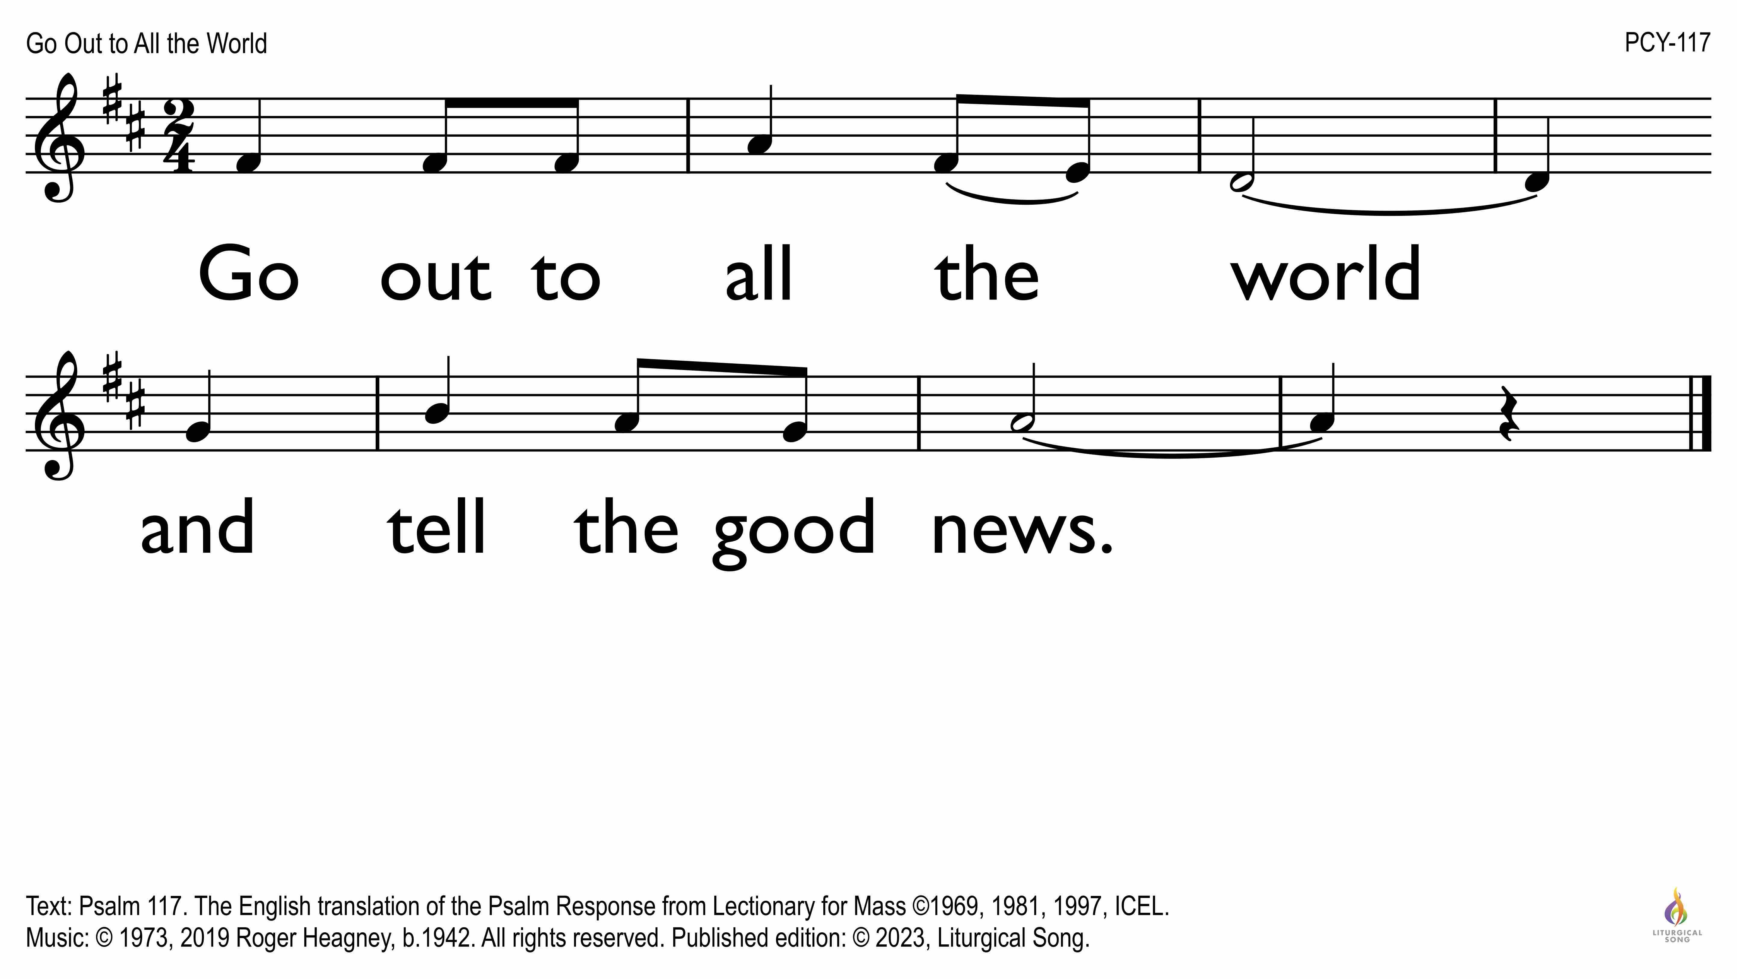

Slide 12
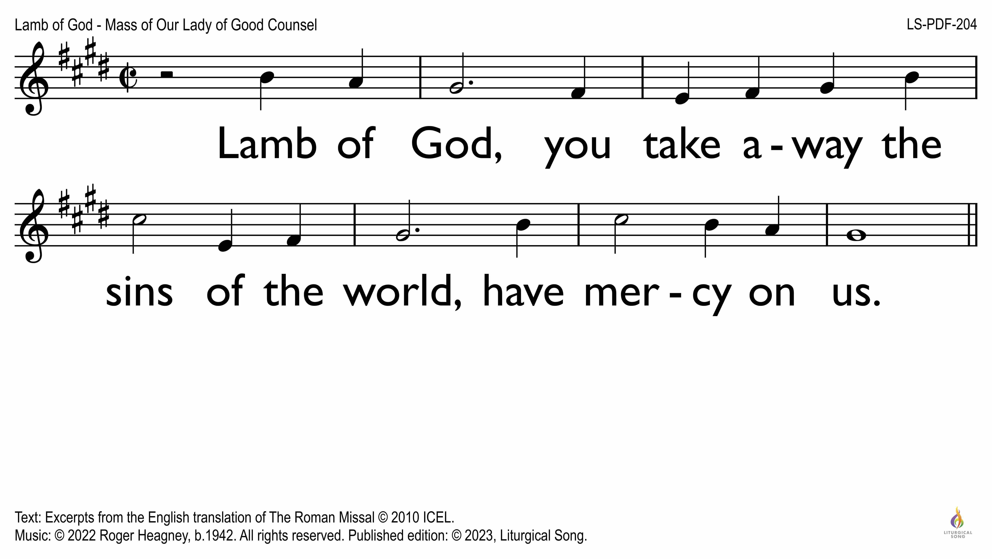

Slide 13
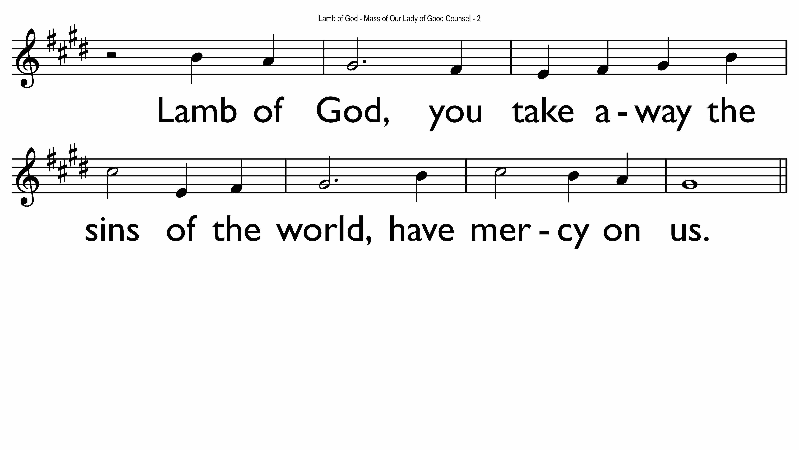

Slide 14
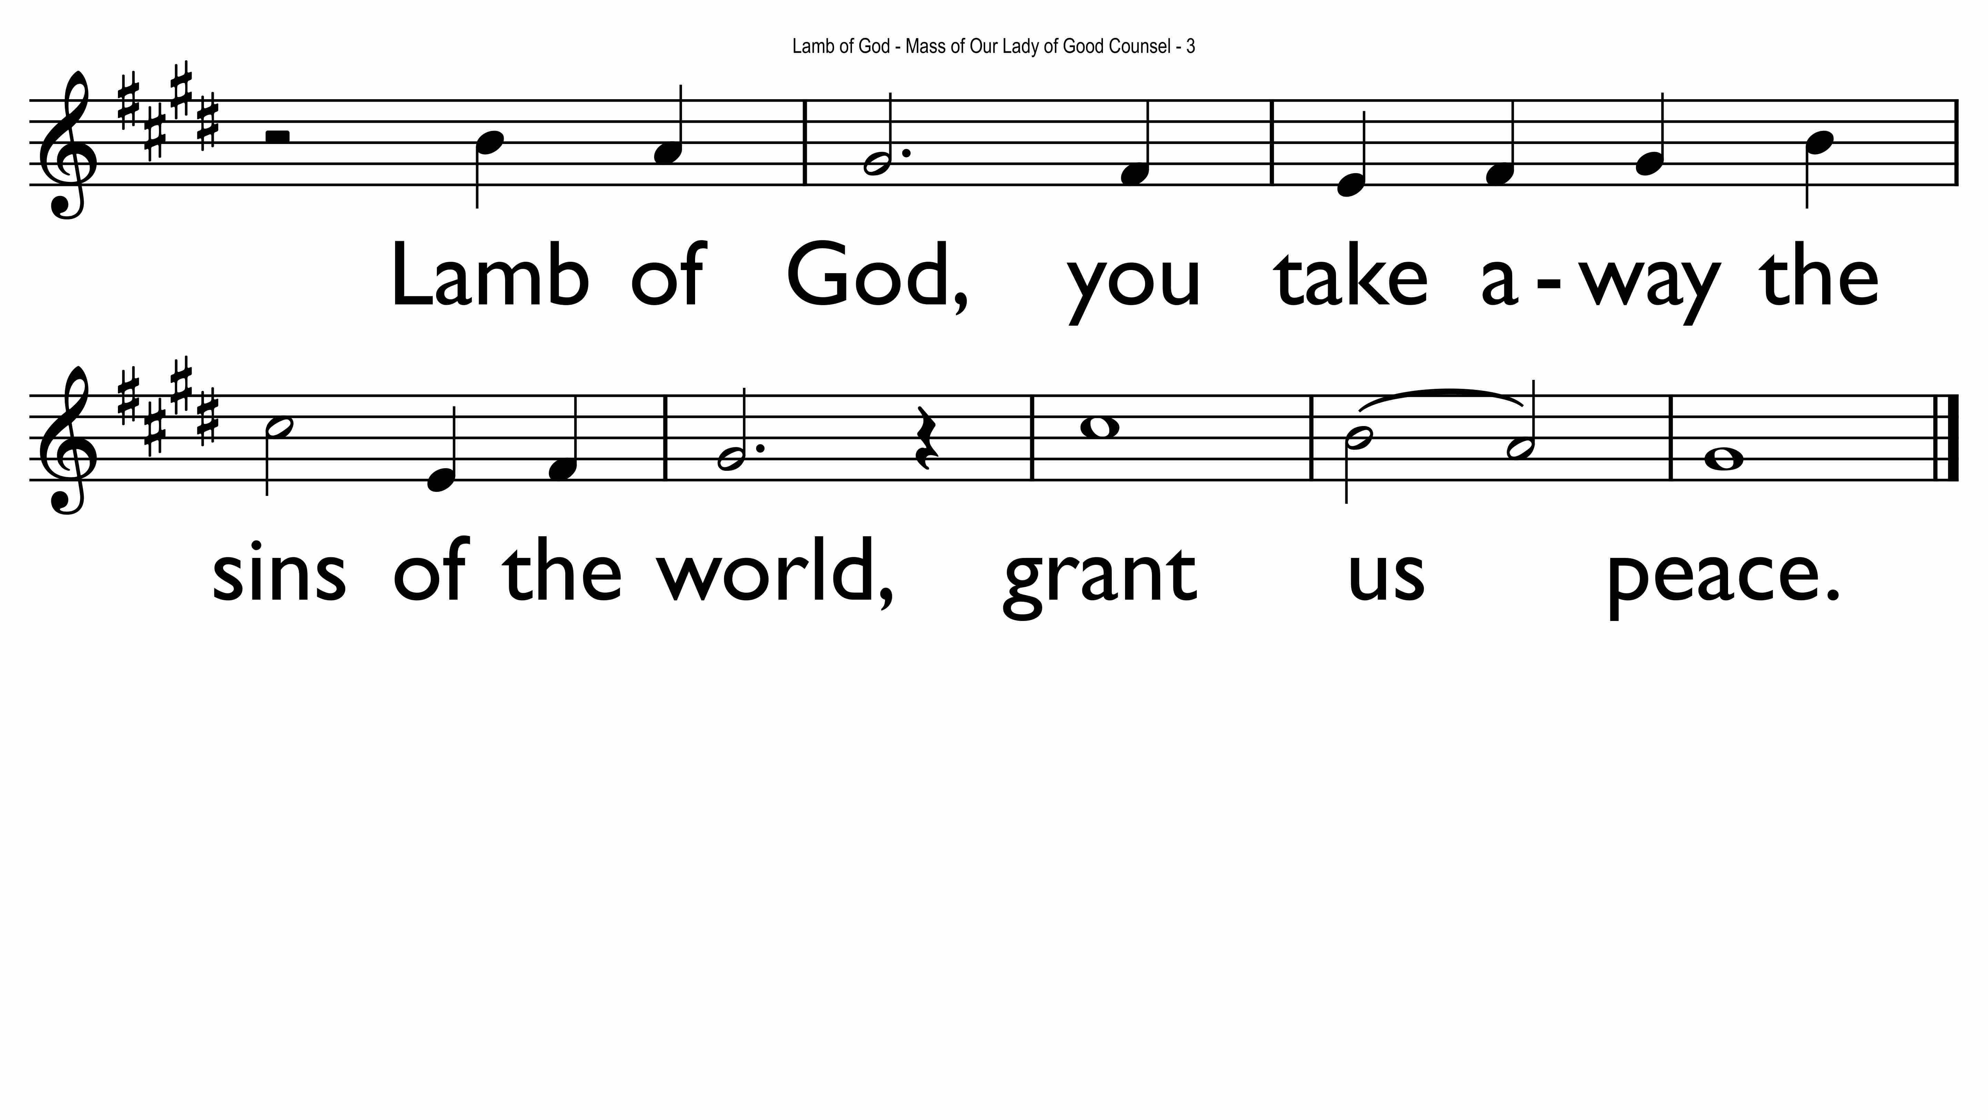

Slide 15
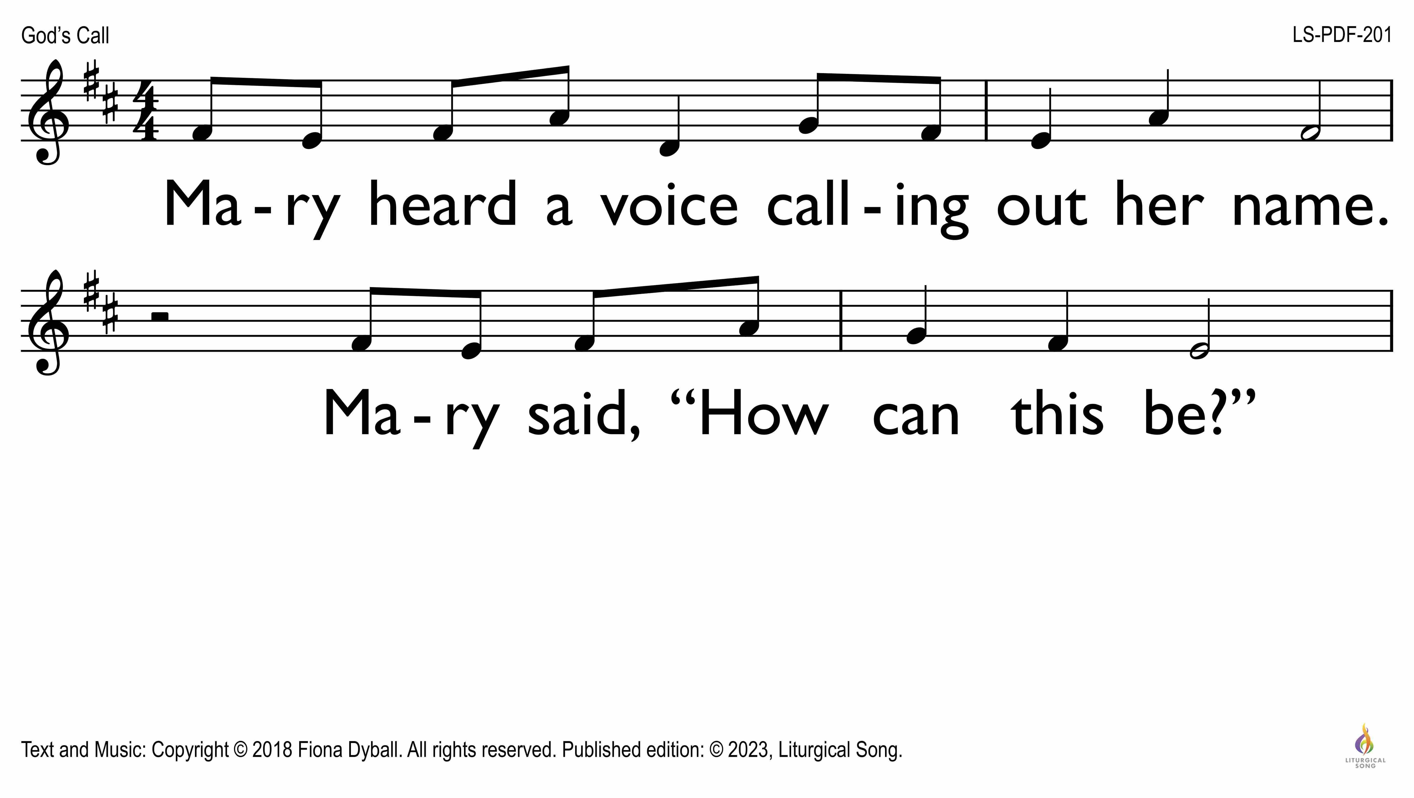

Slide 16
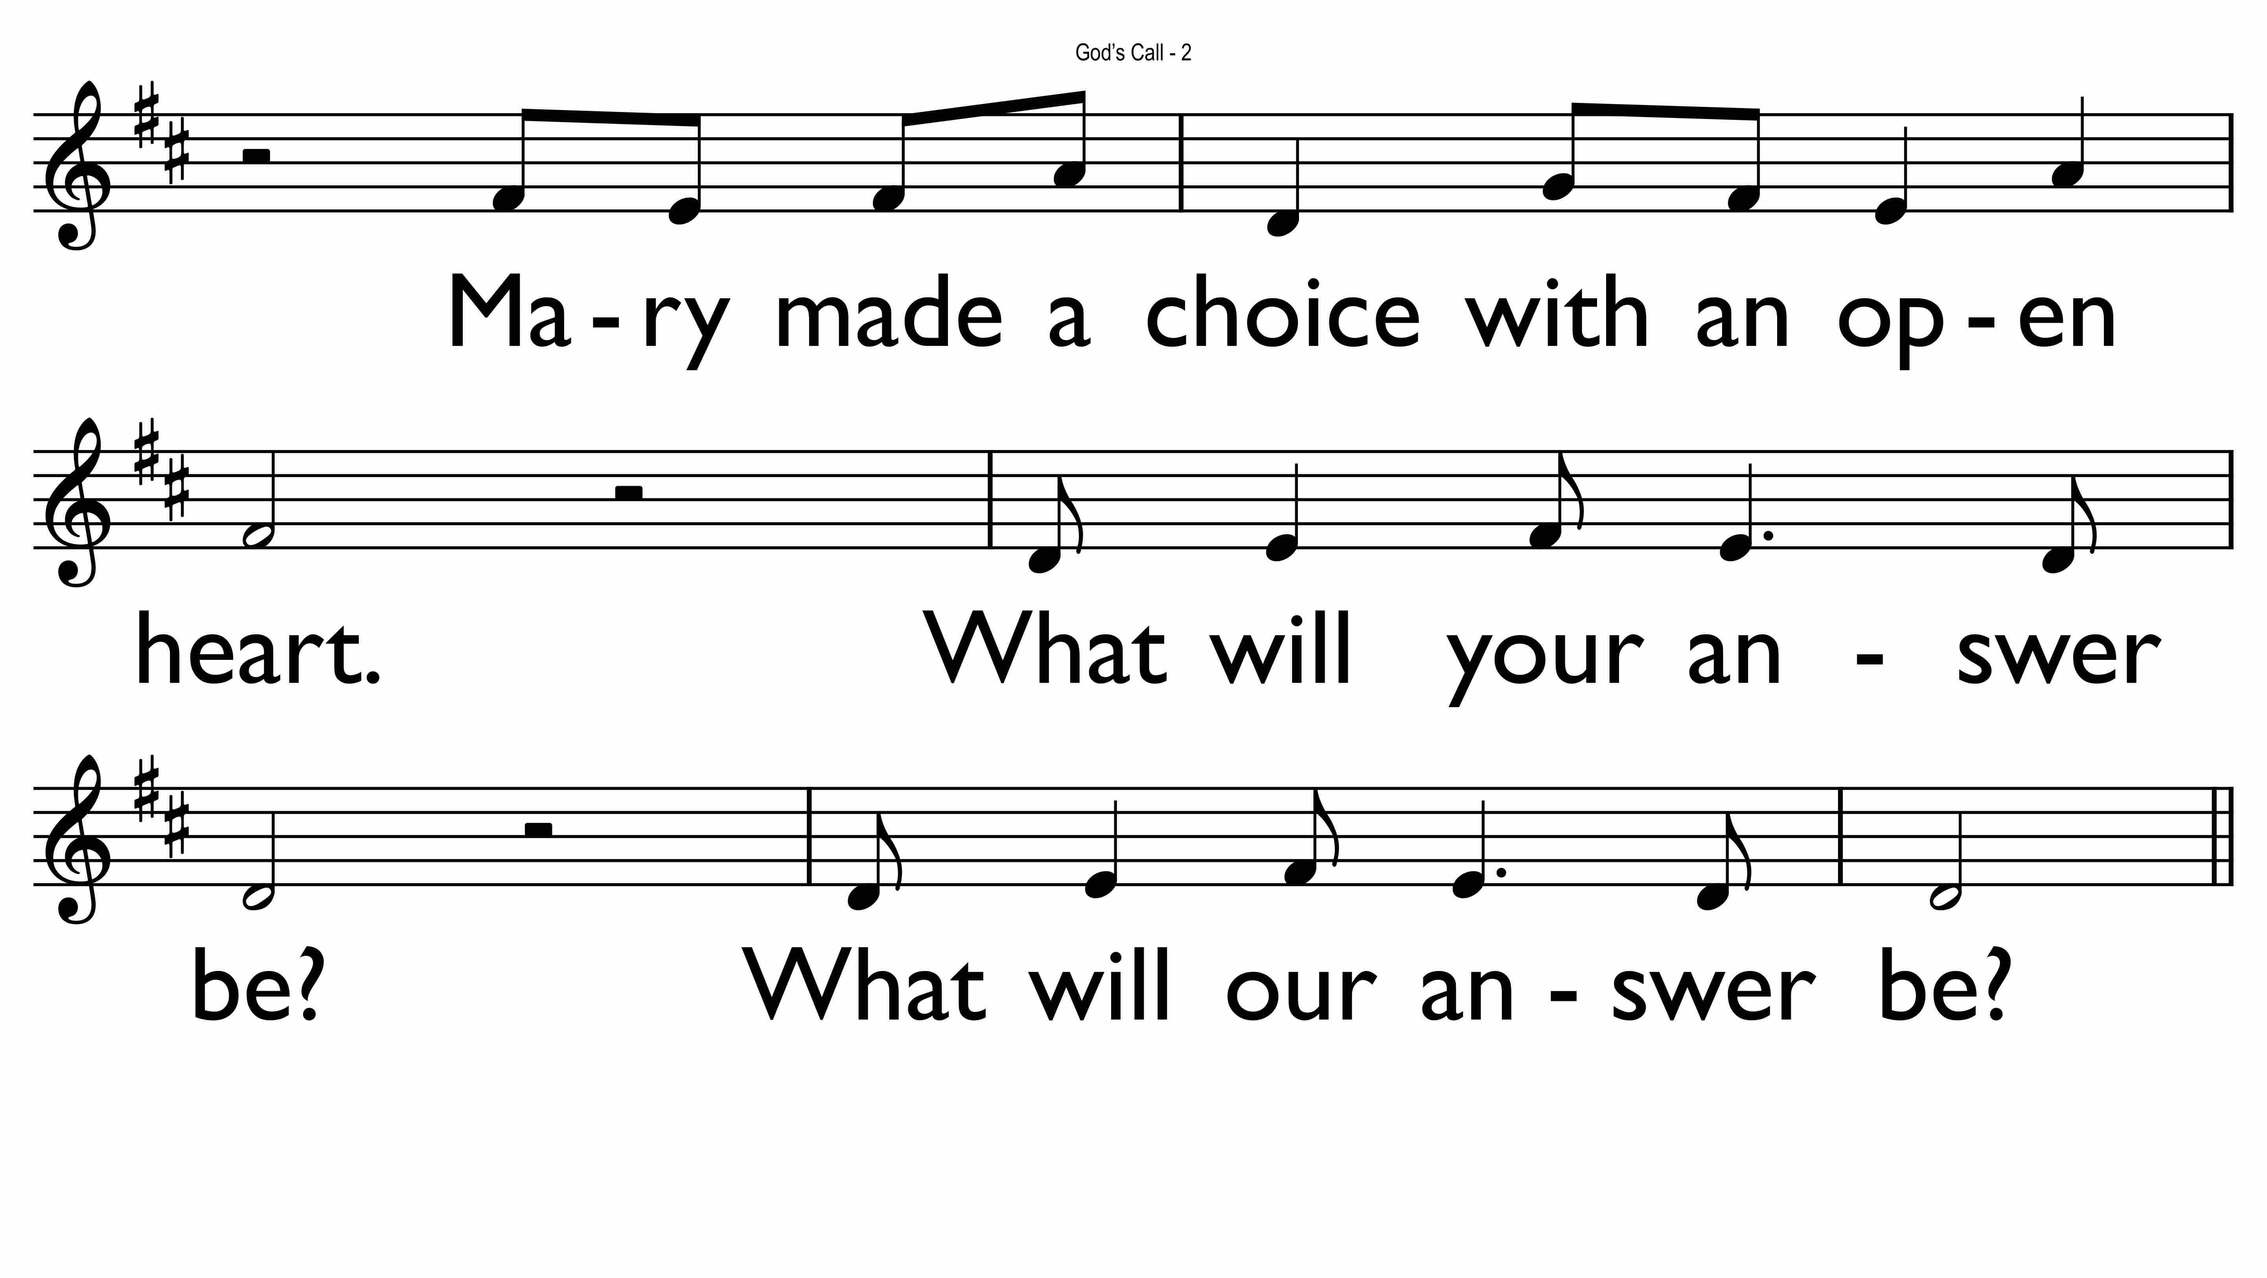

Slide 17
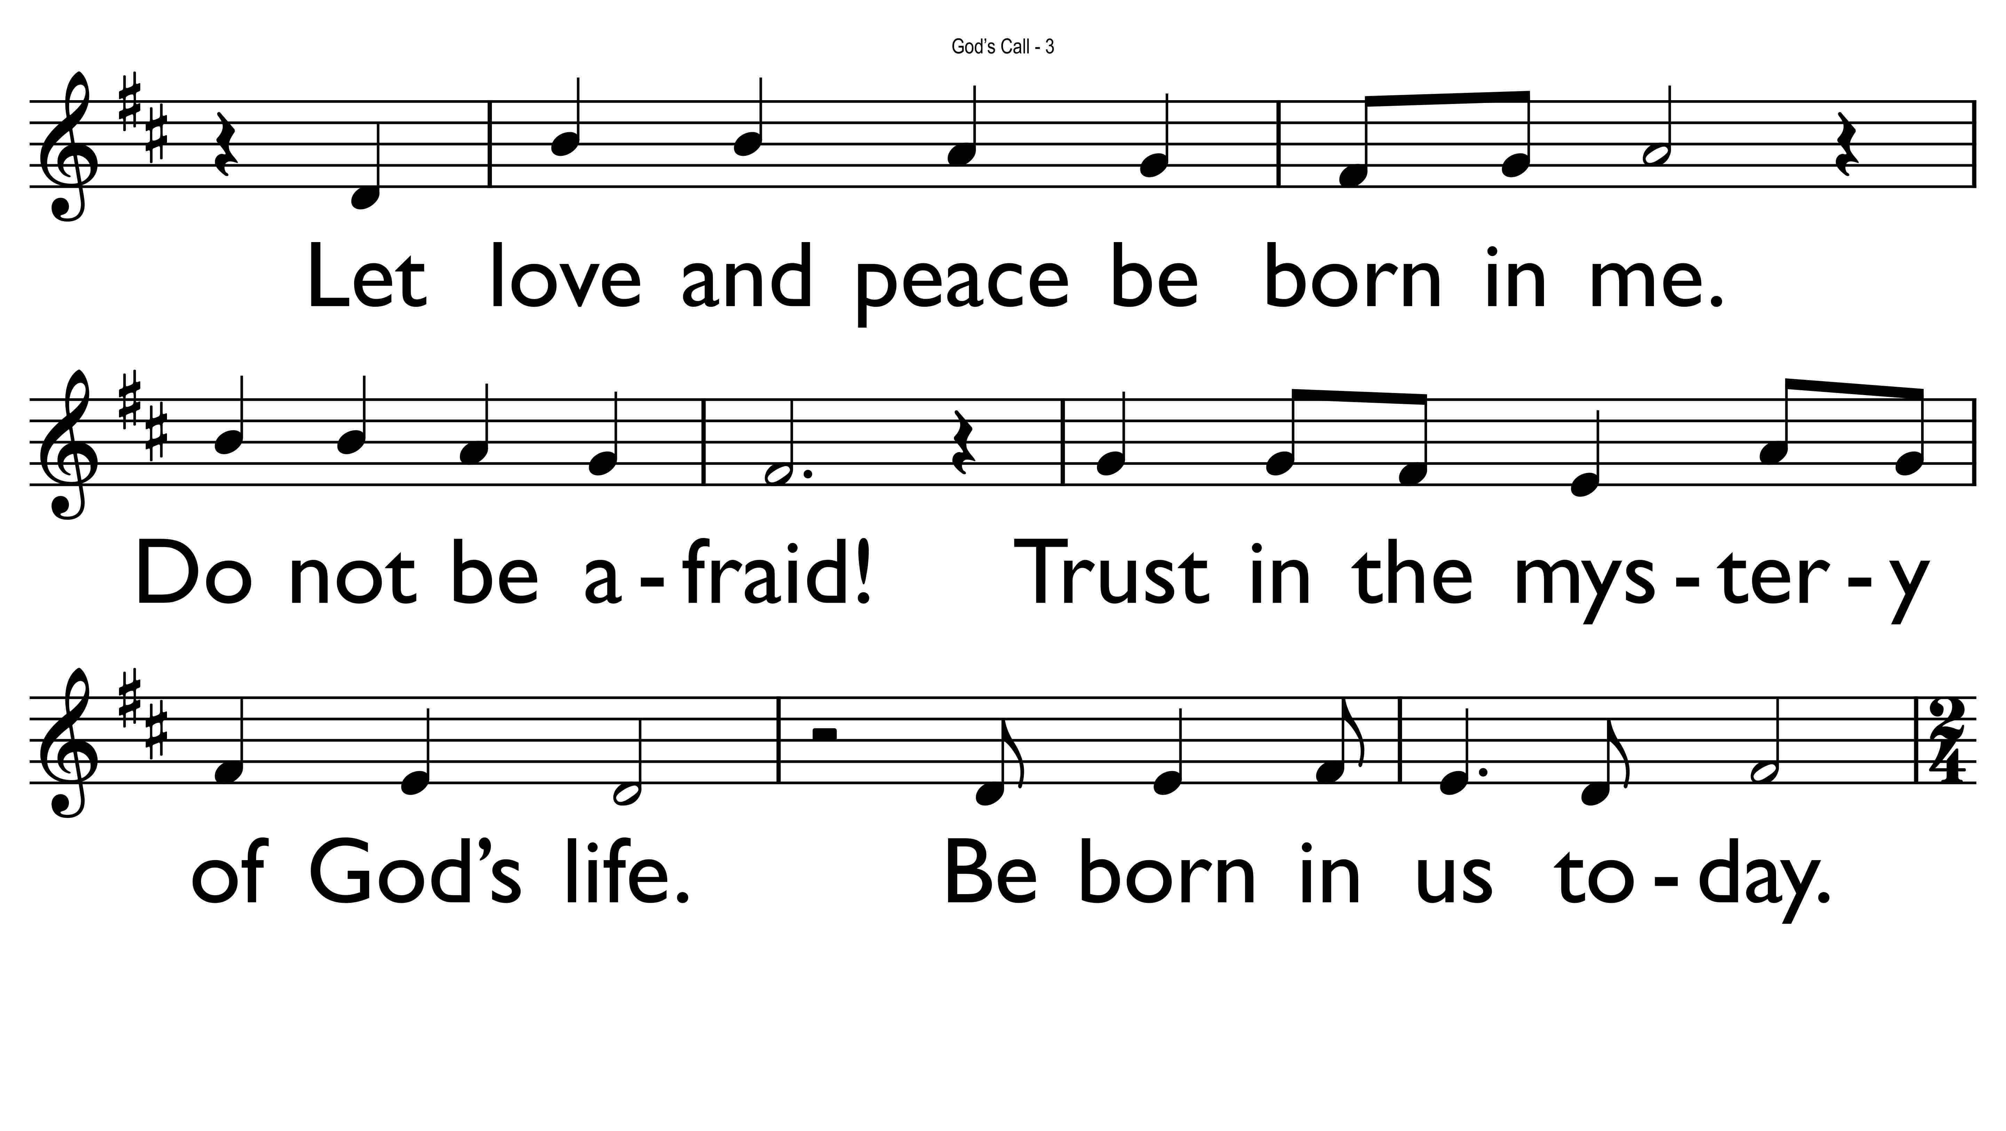

Slide 18
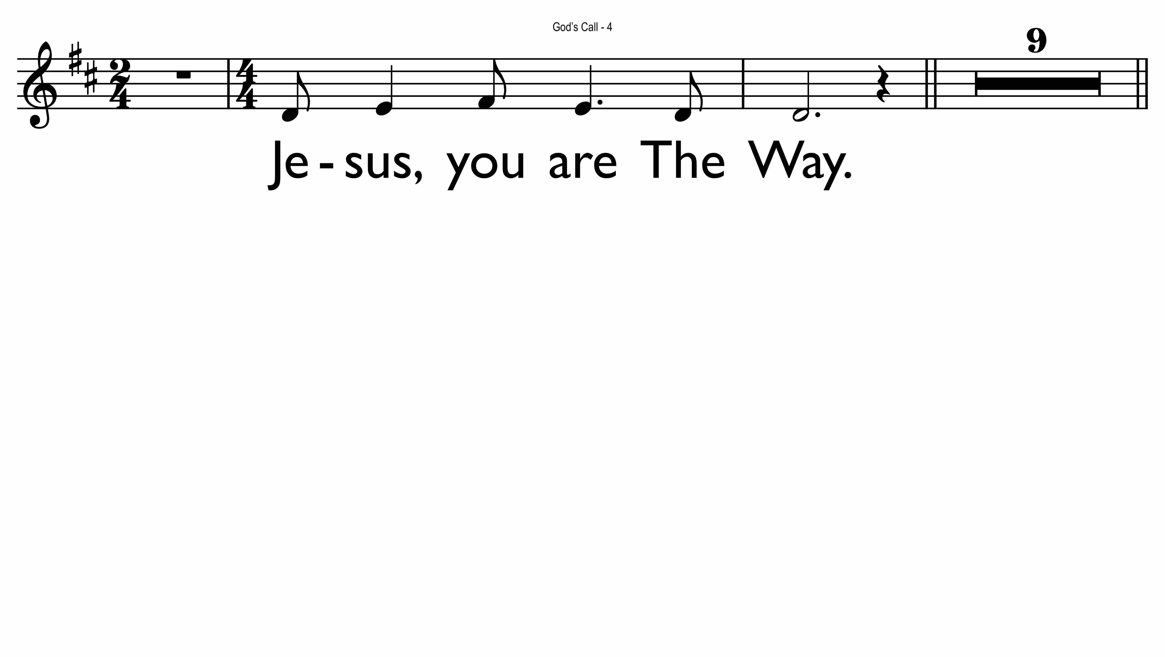

Slide 19
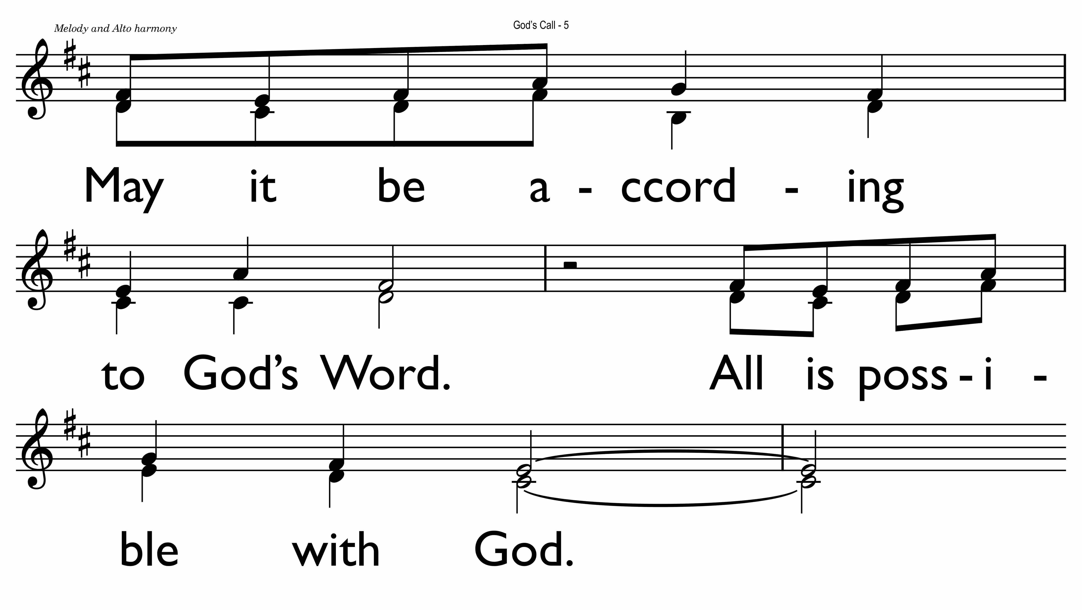

Slide 20
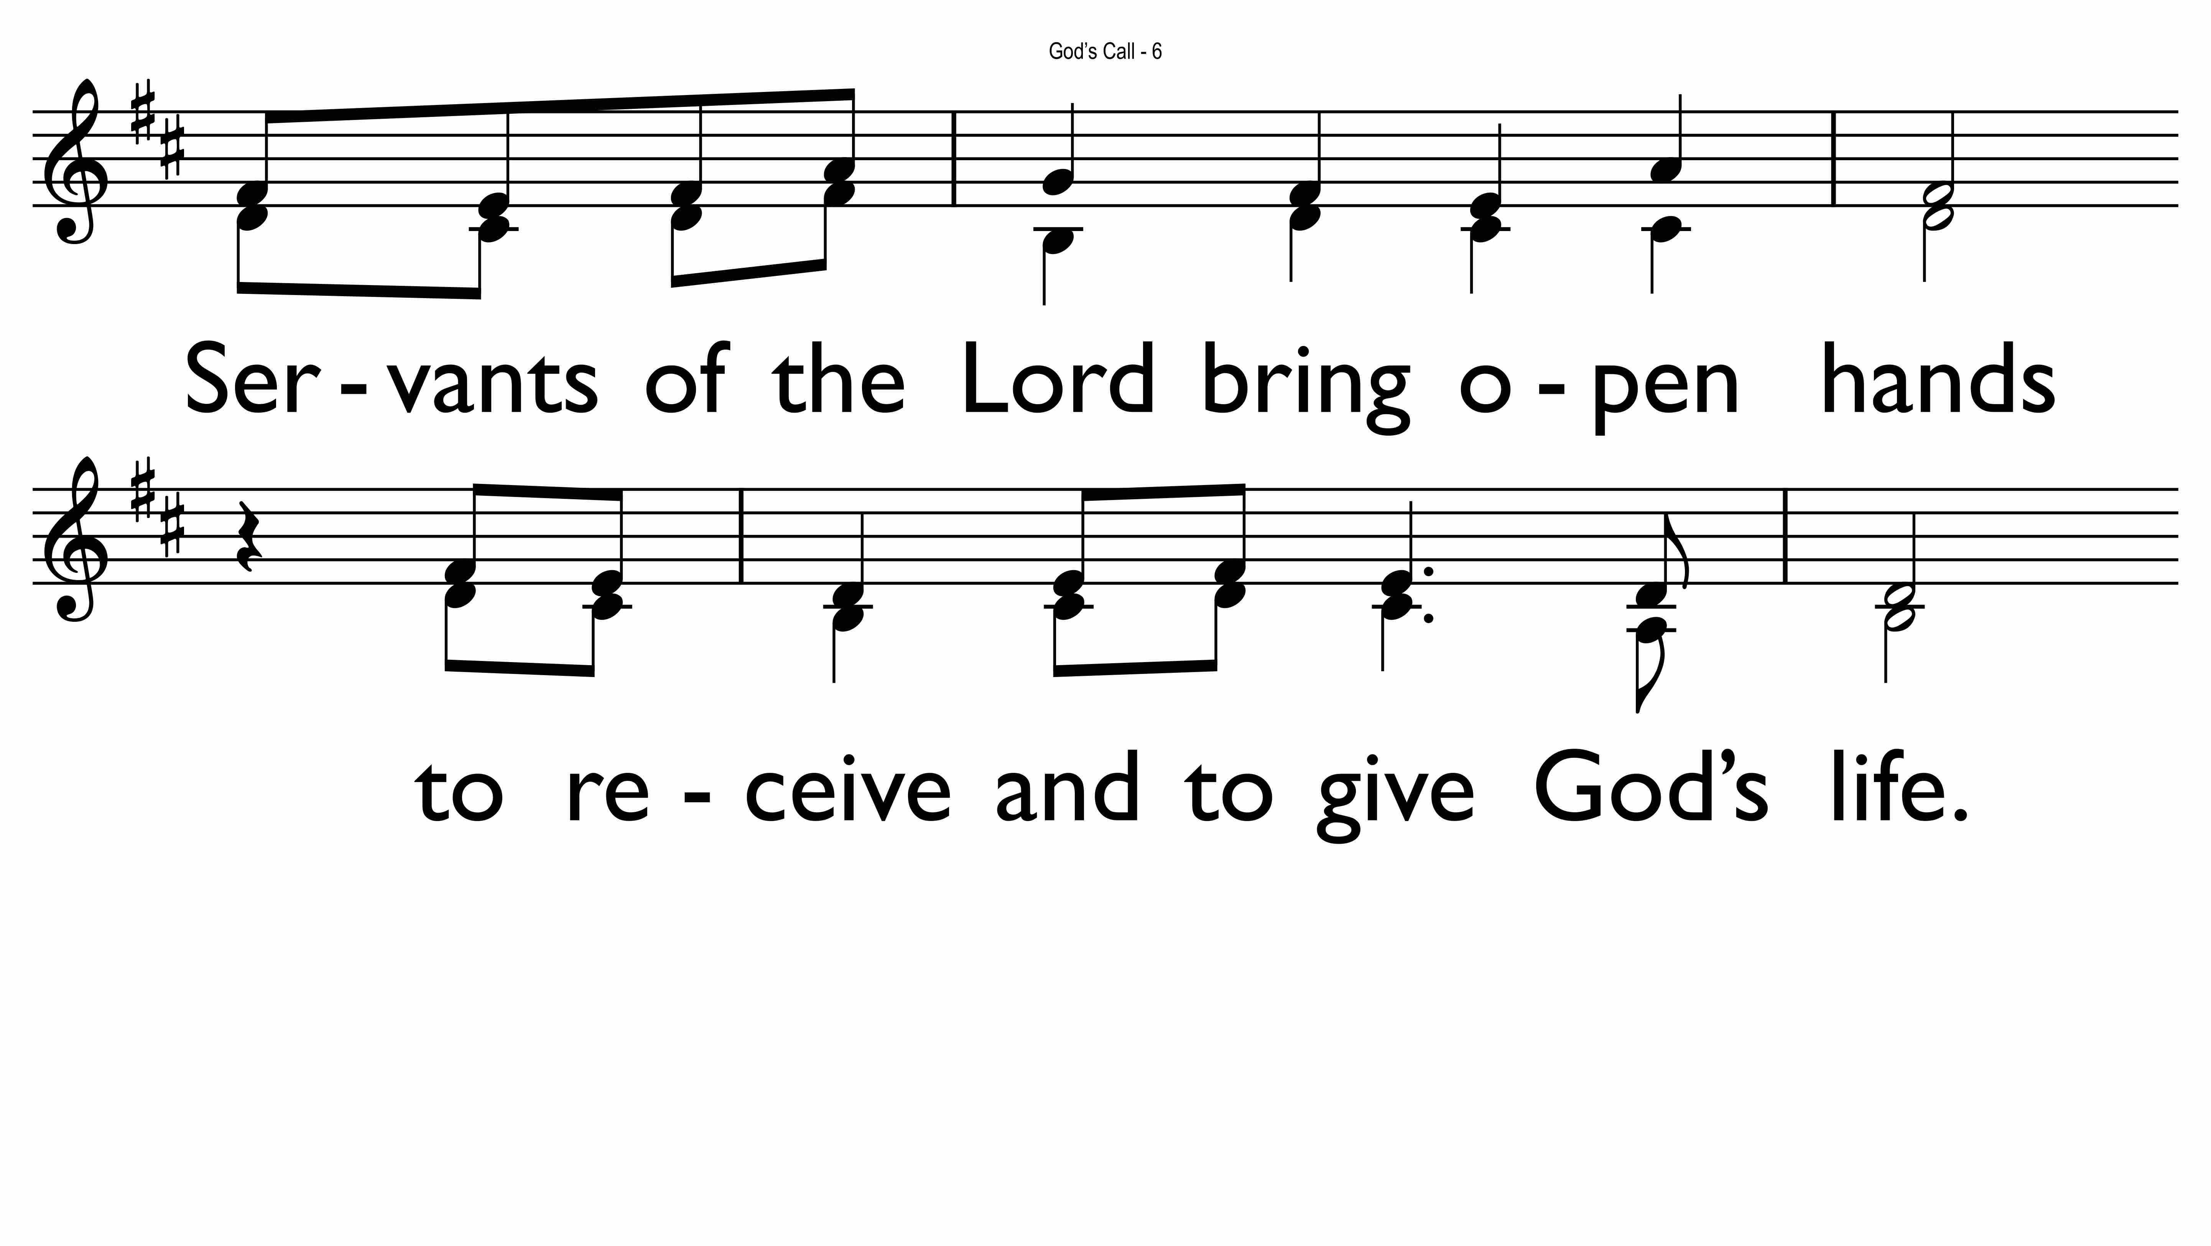

Slide 21
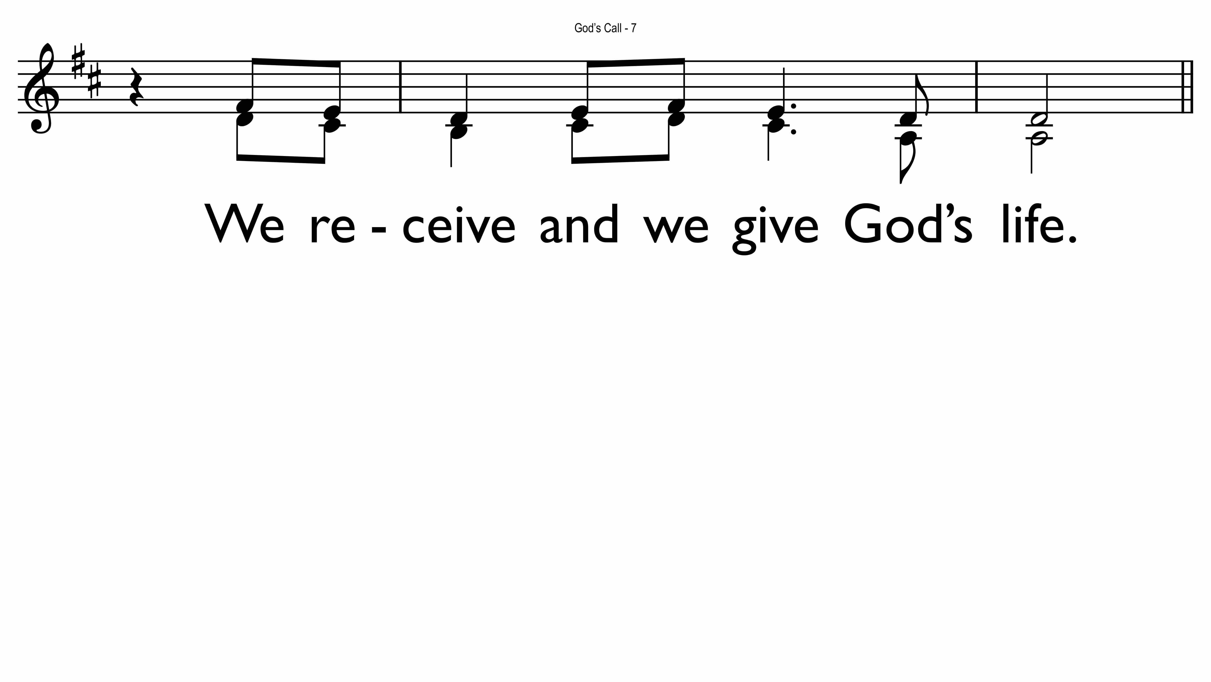

Slide 22
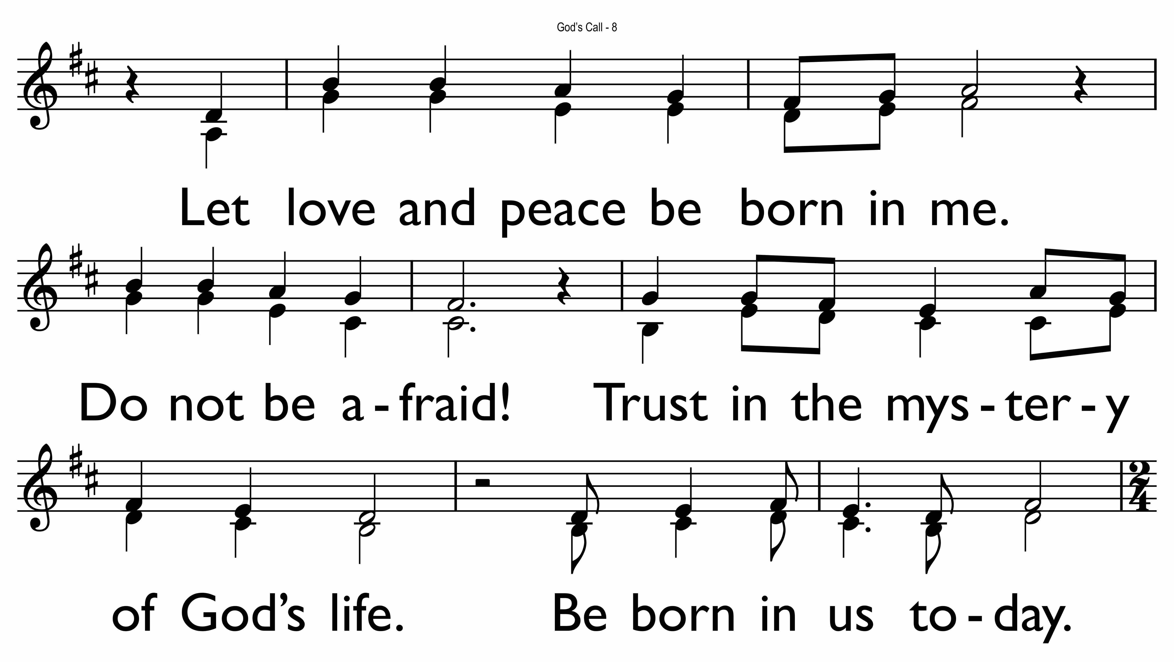

Slide 23
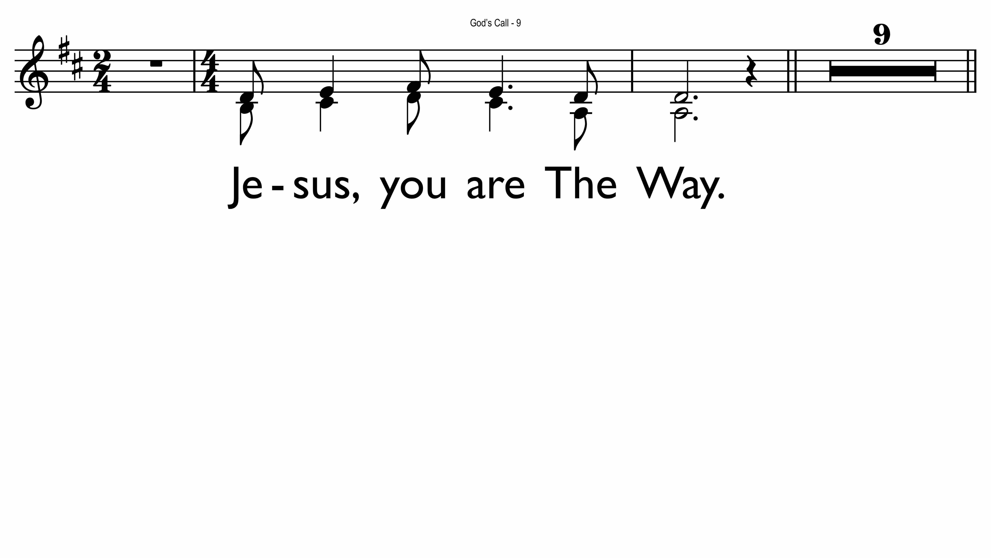

Slide 24
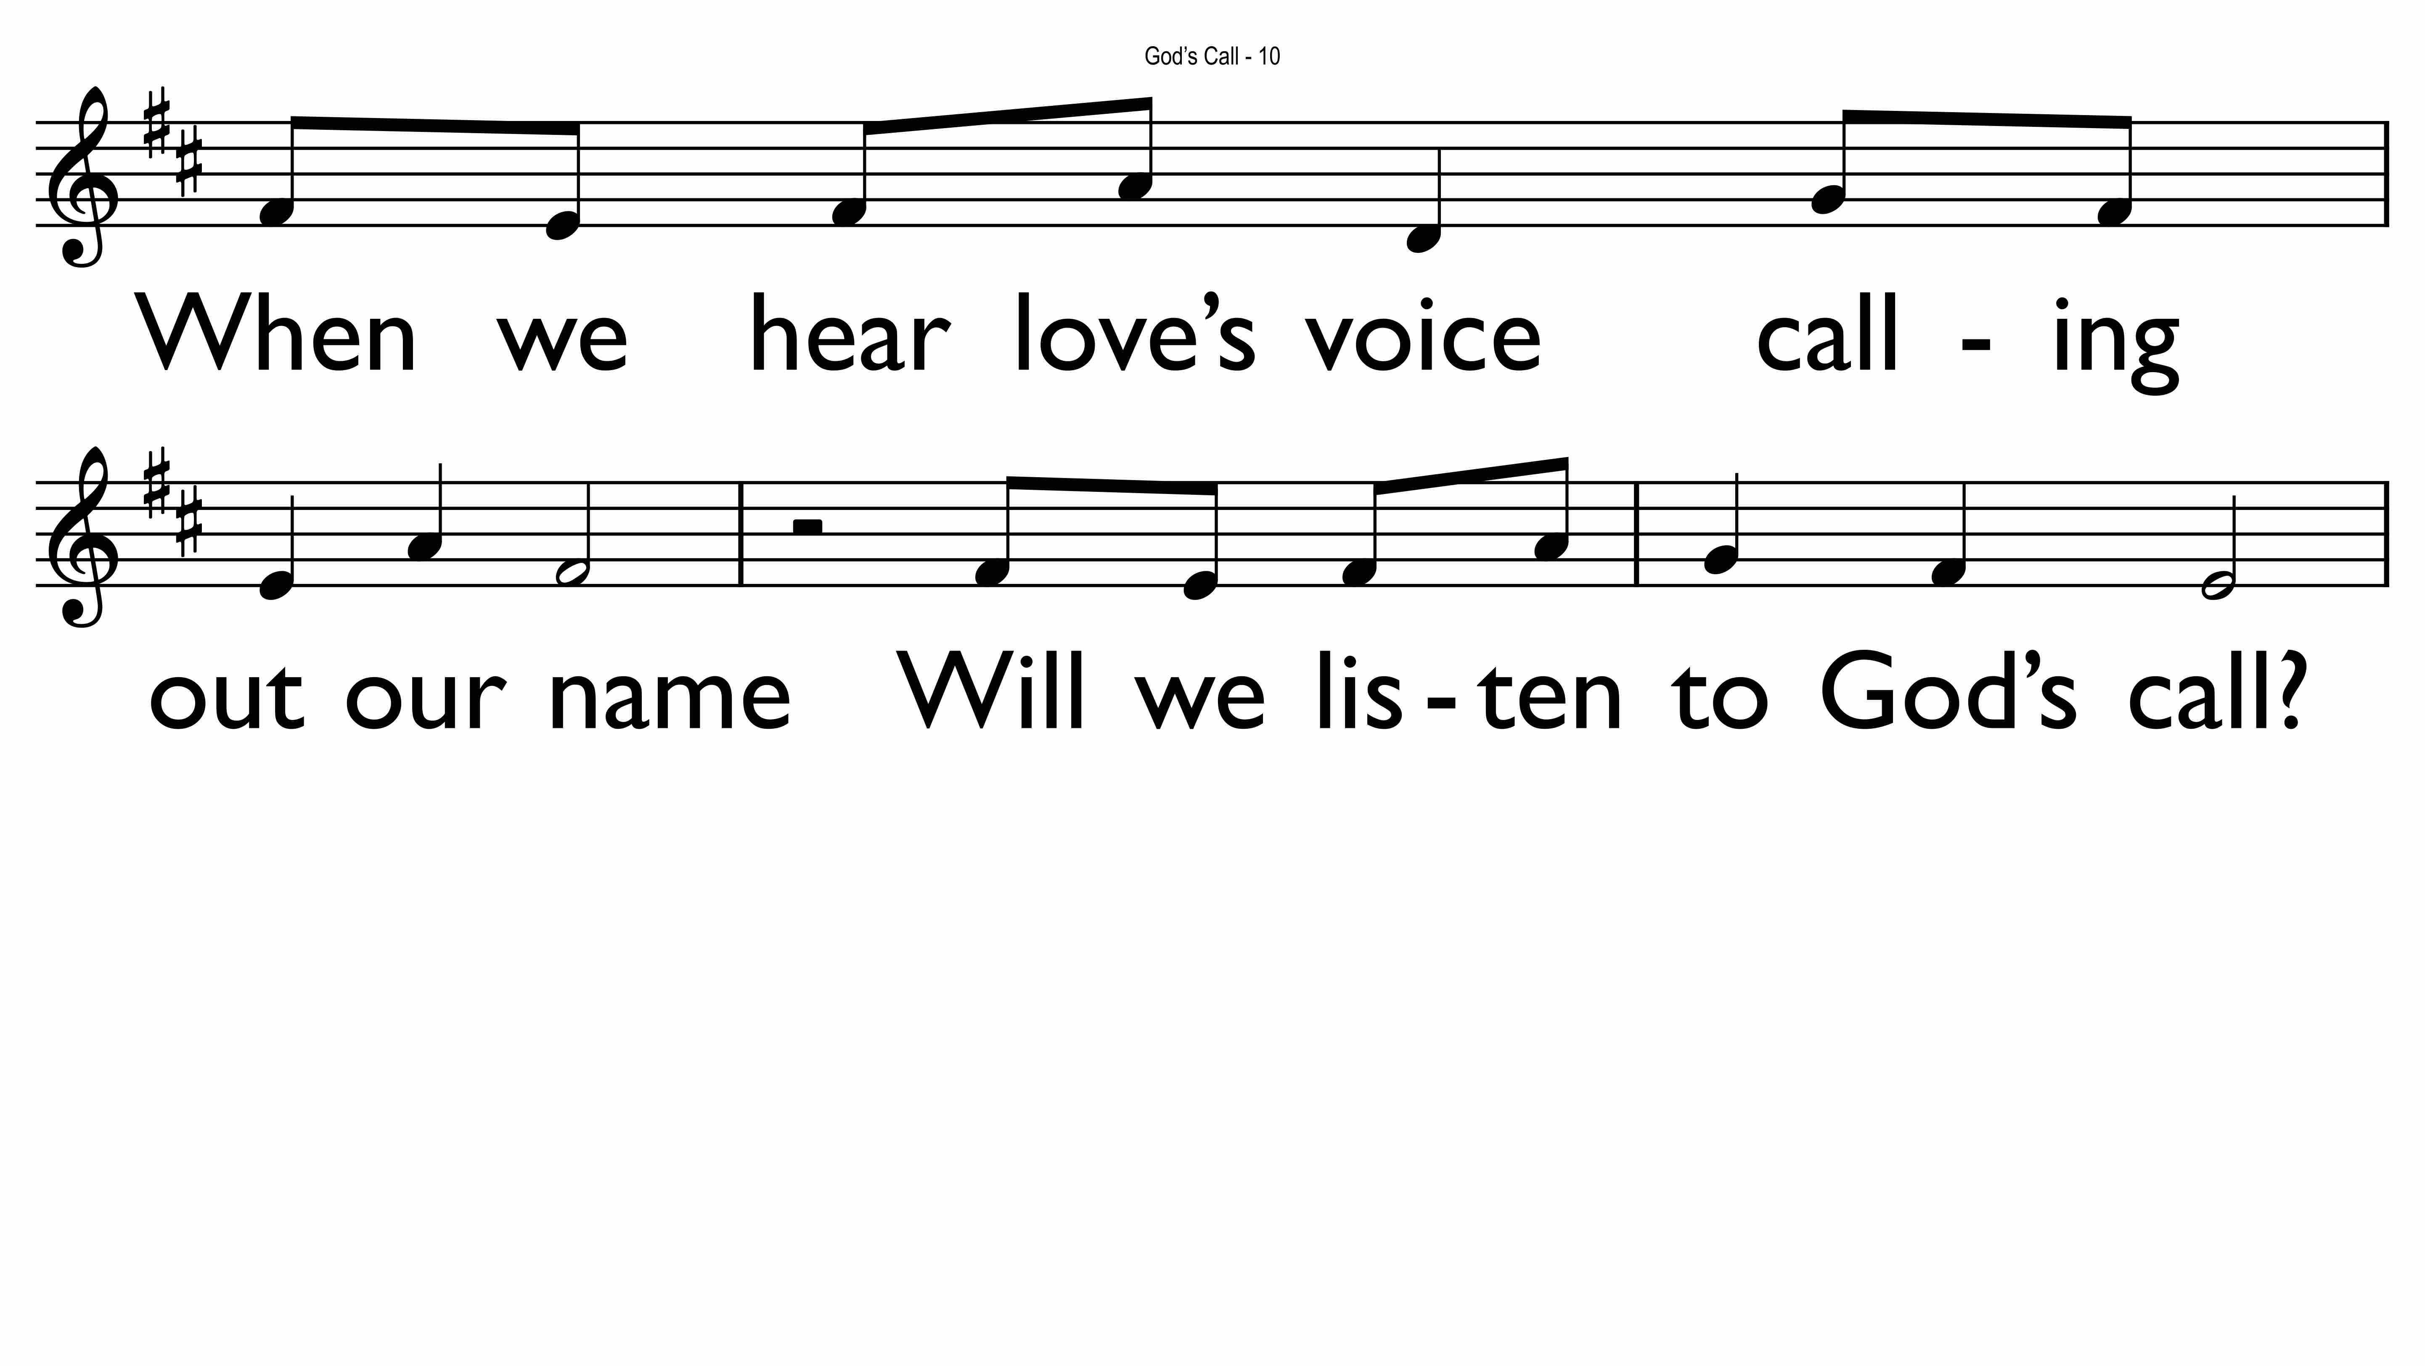

Slide 25
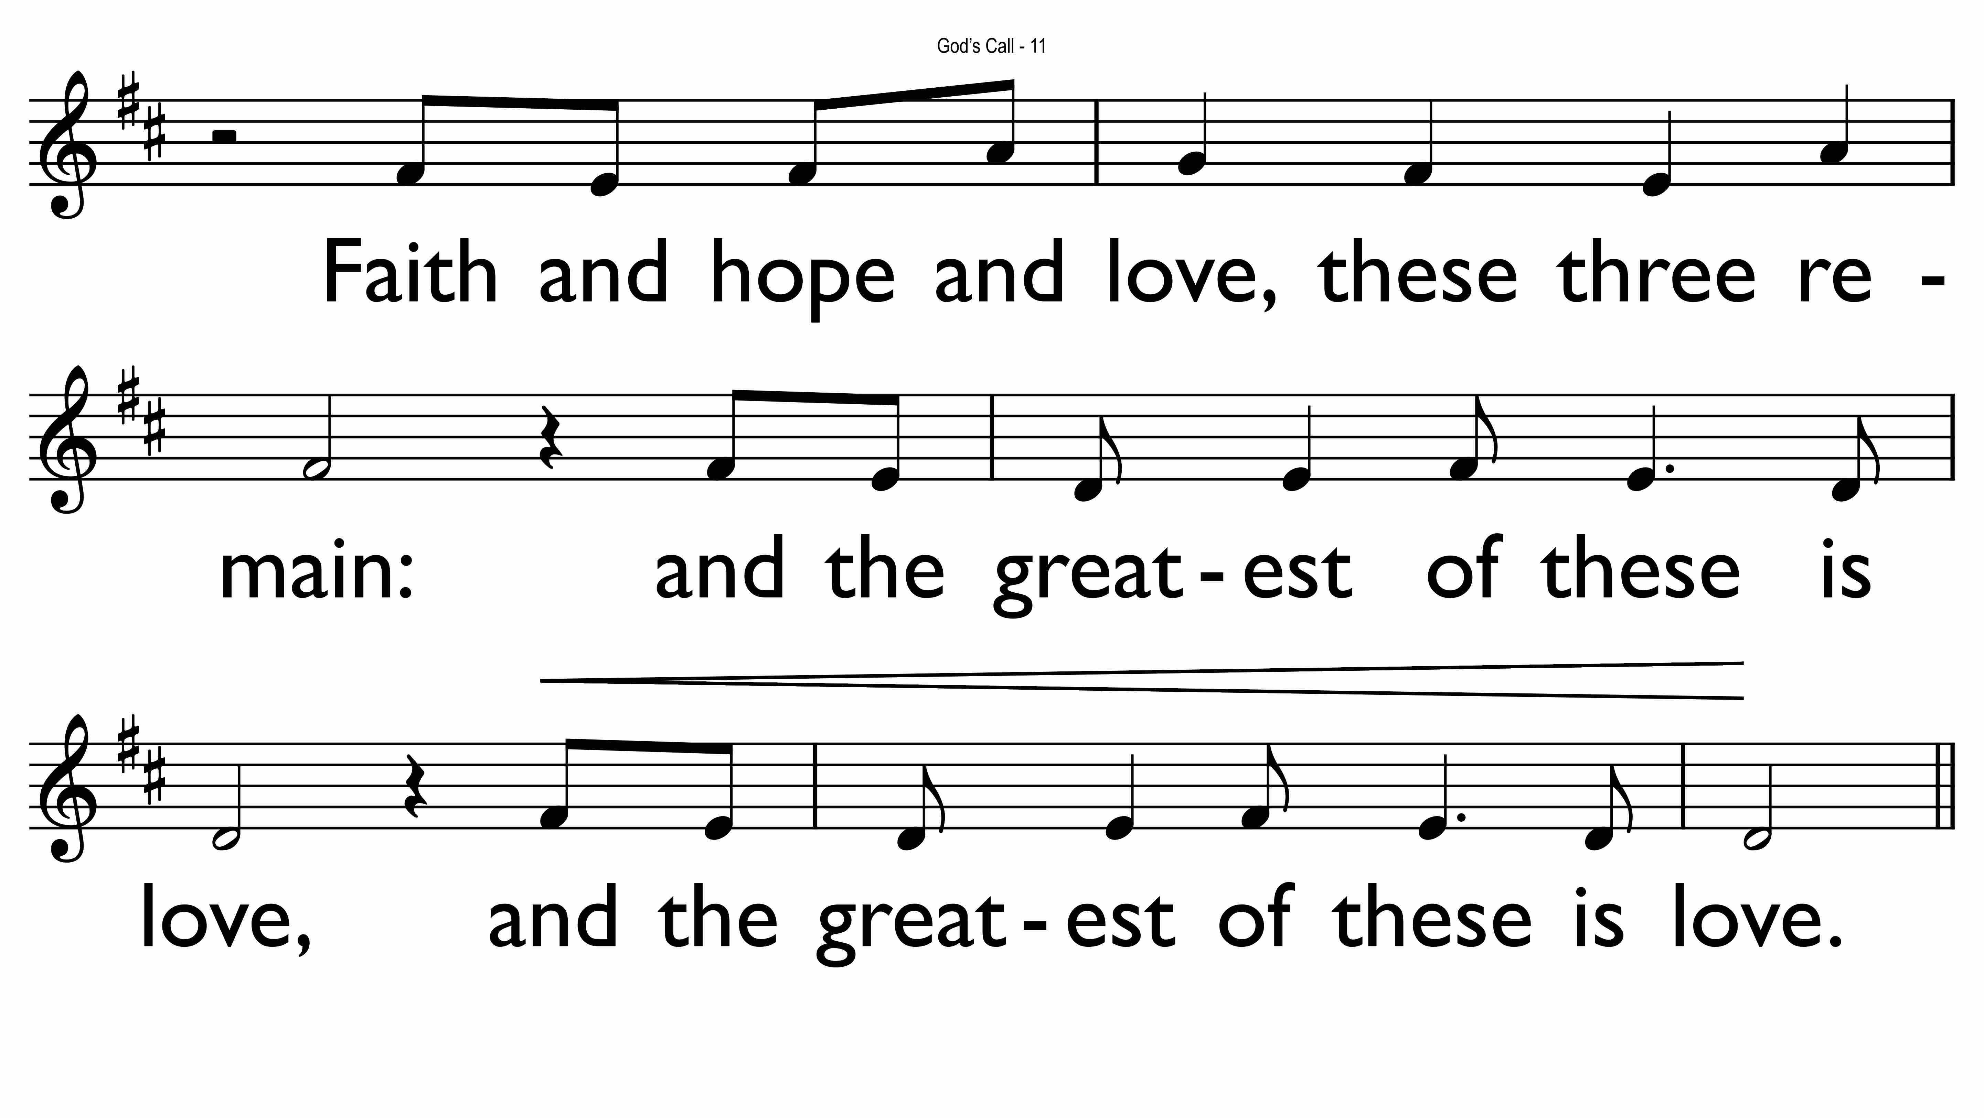

Slide 26
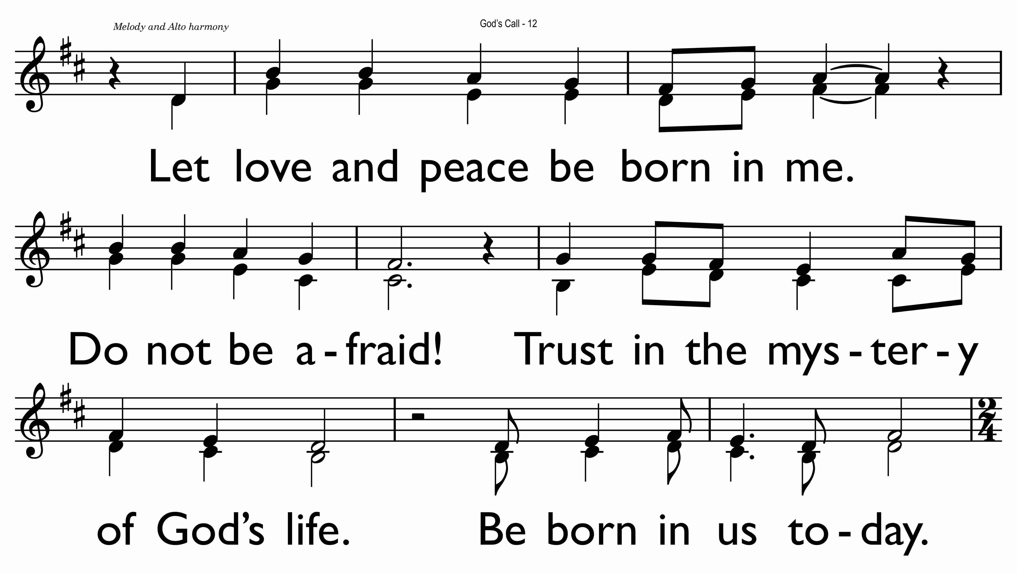

Slide 27
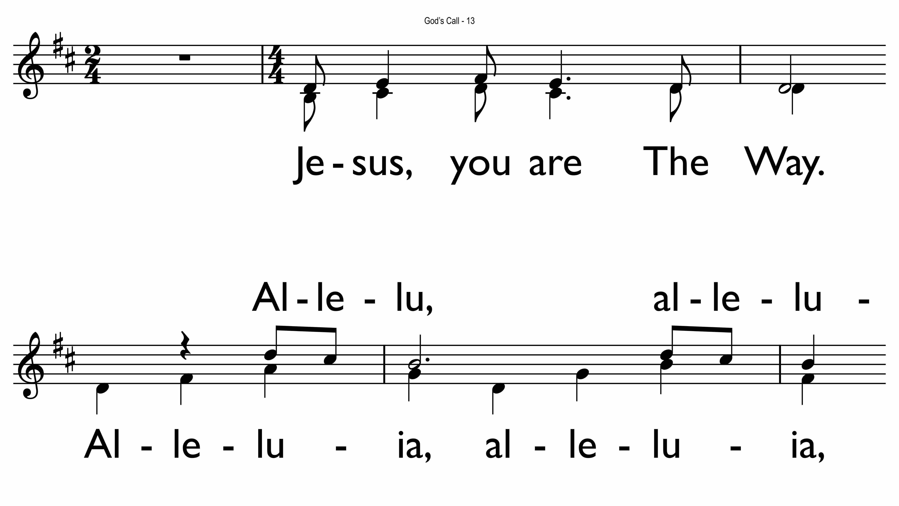

Slide 28
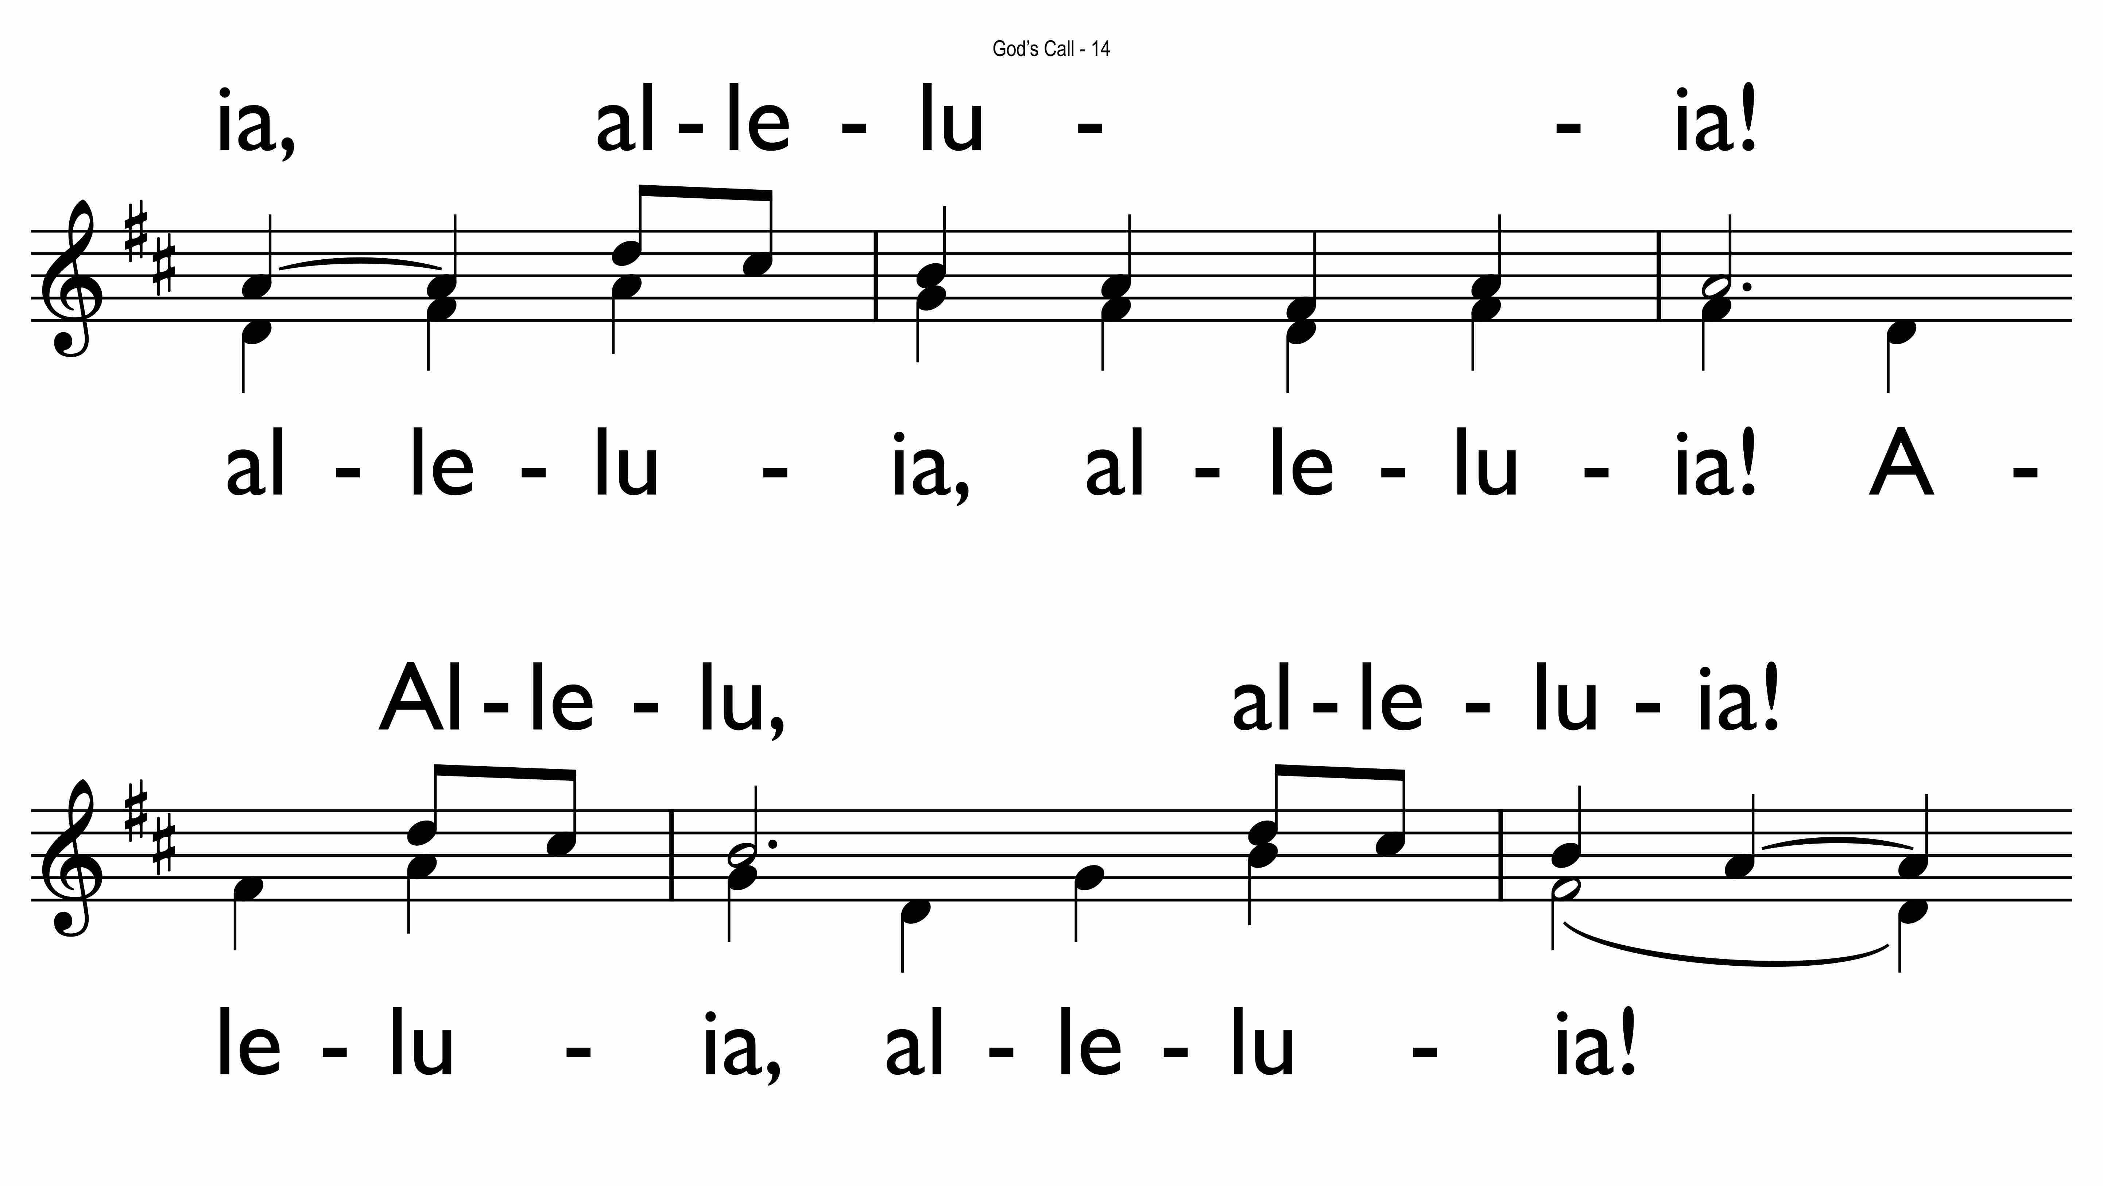

Slide 29
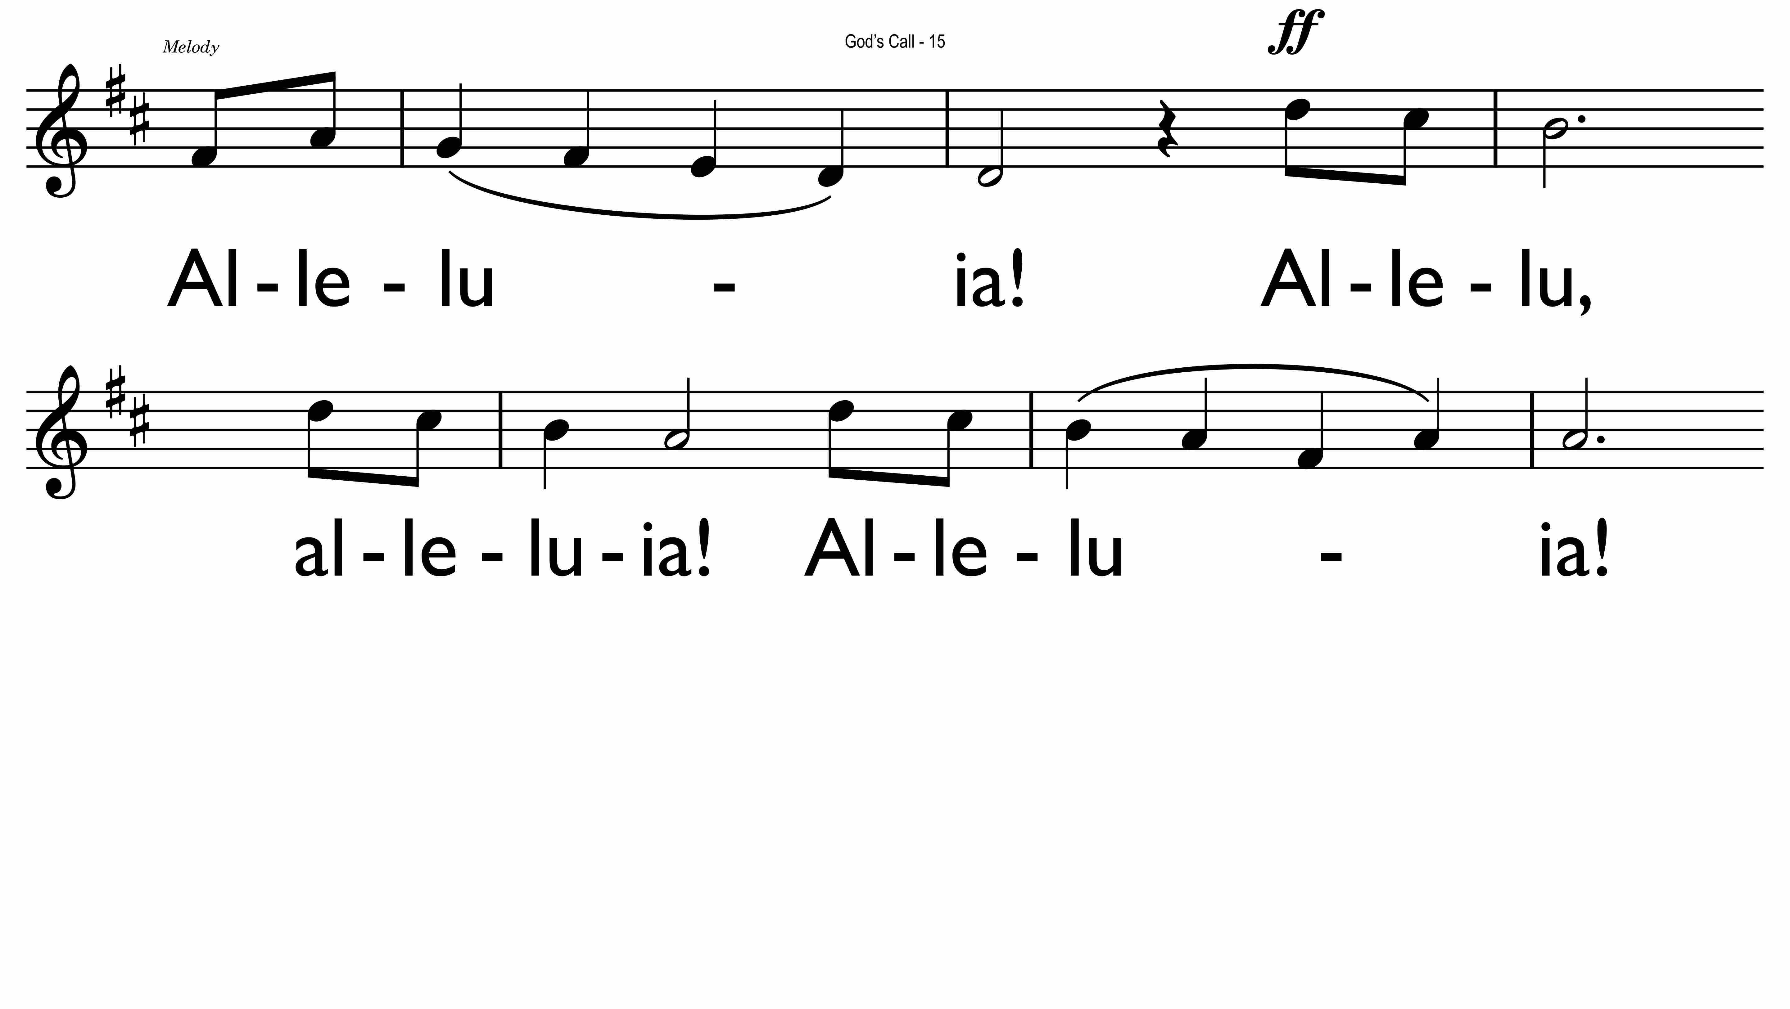

Slide 30
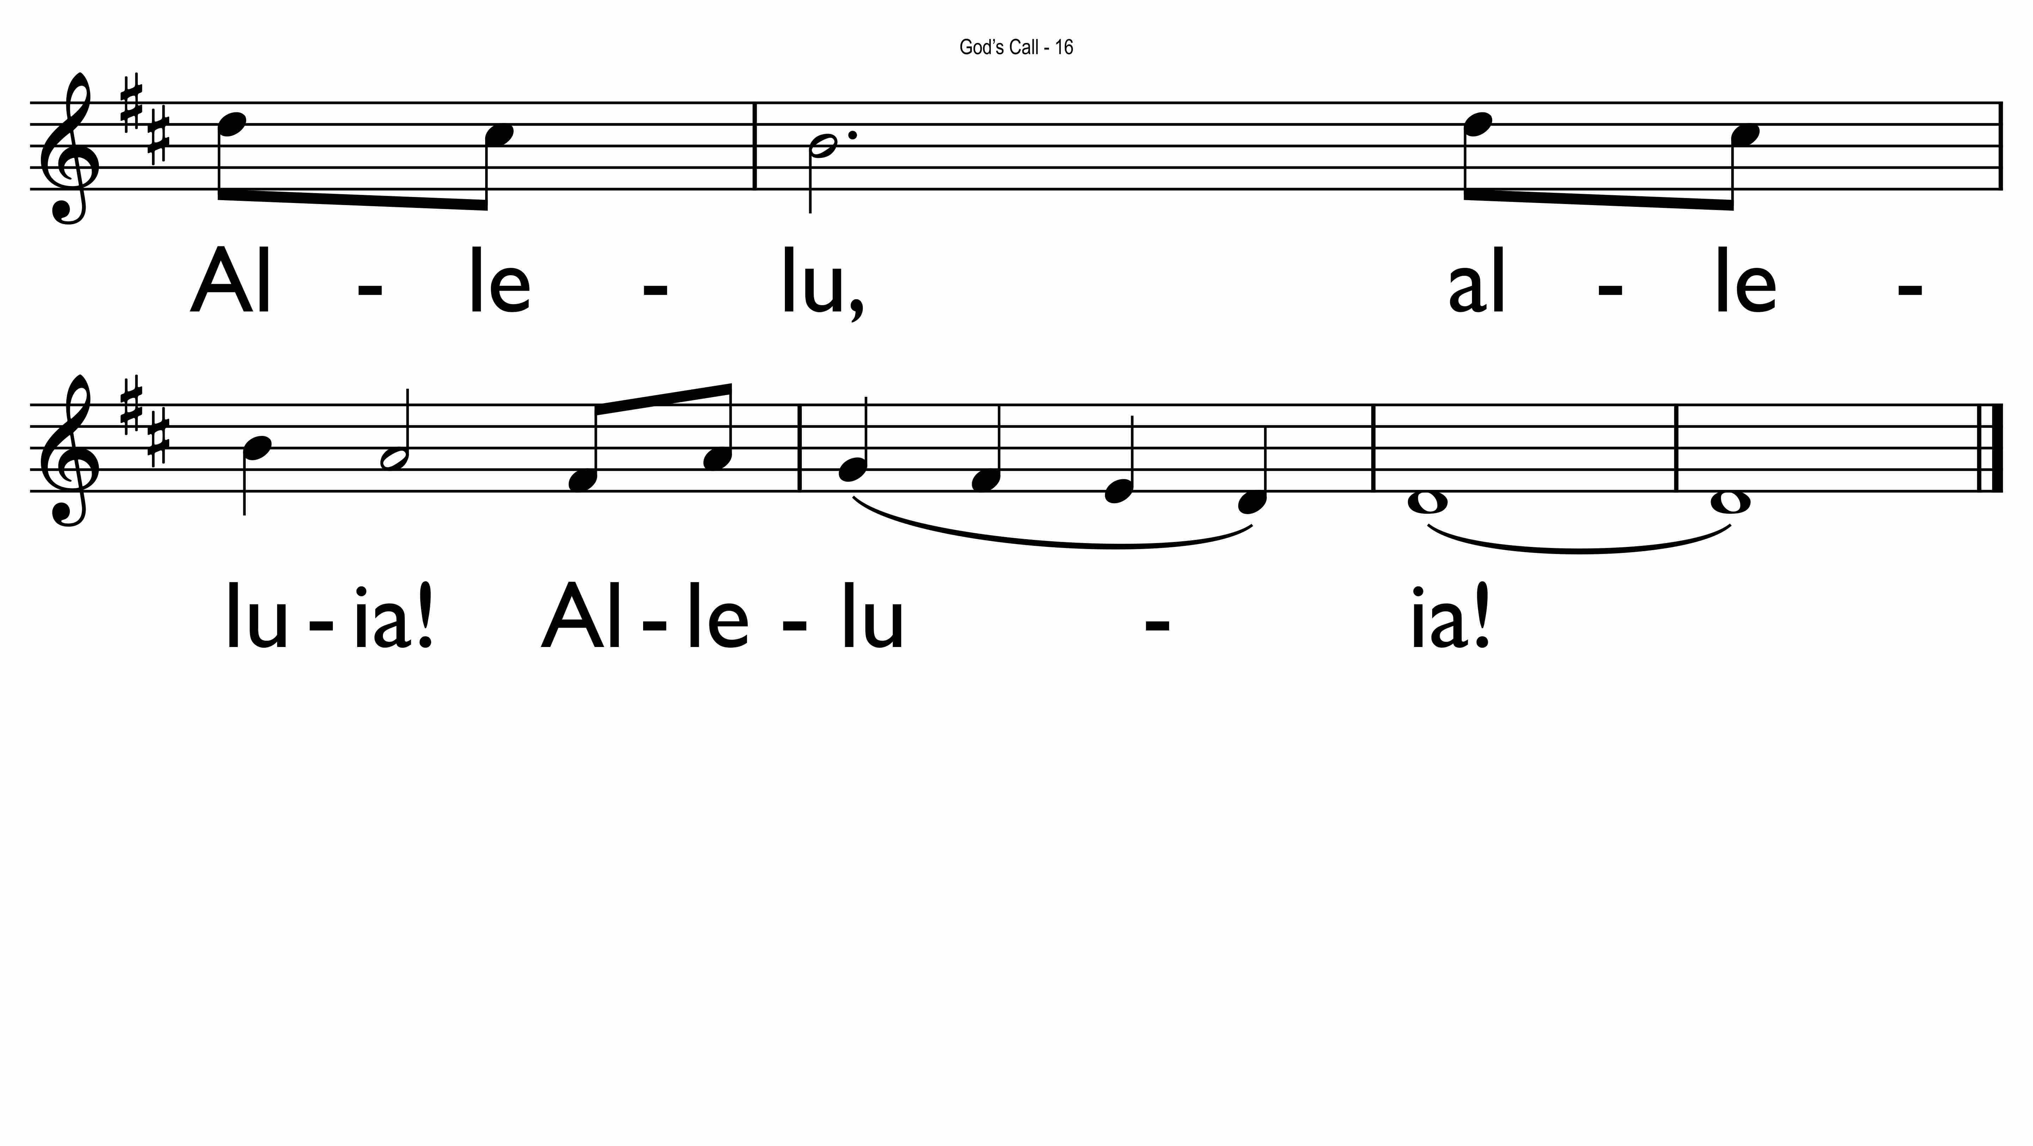

Slide 31
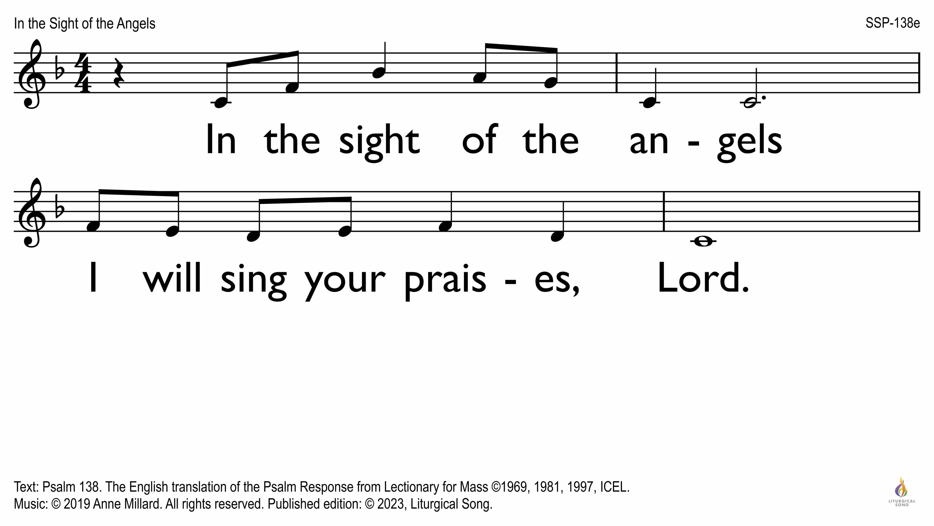

Slide 32
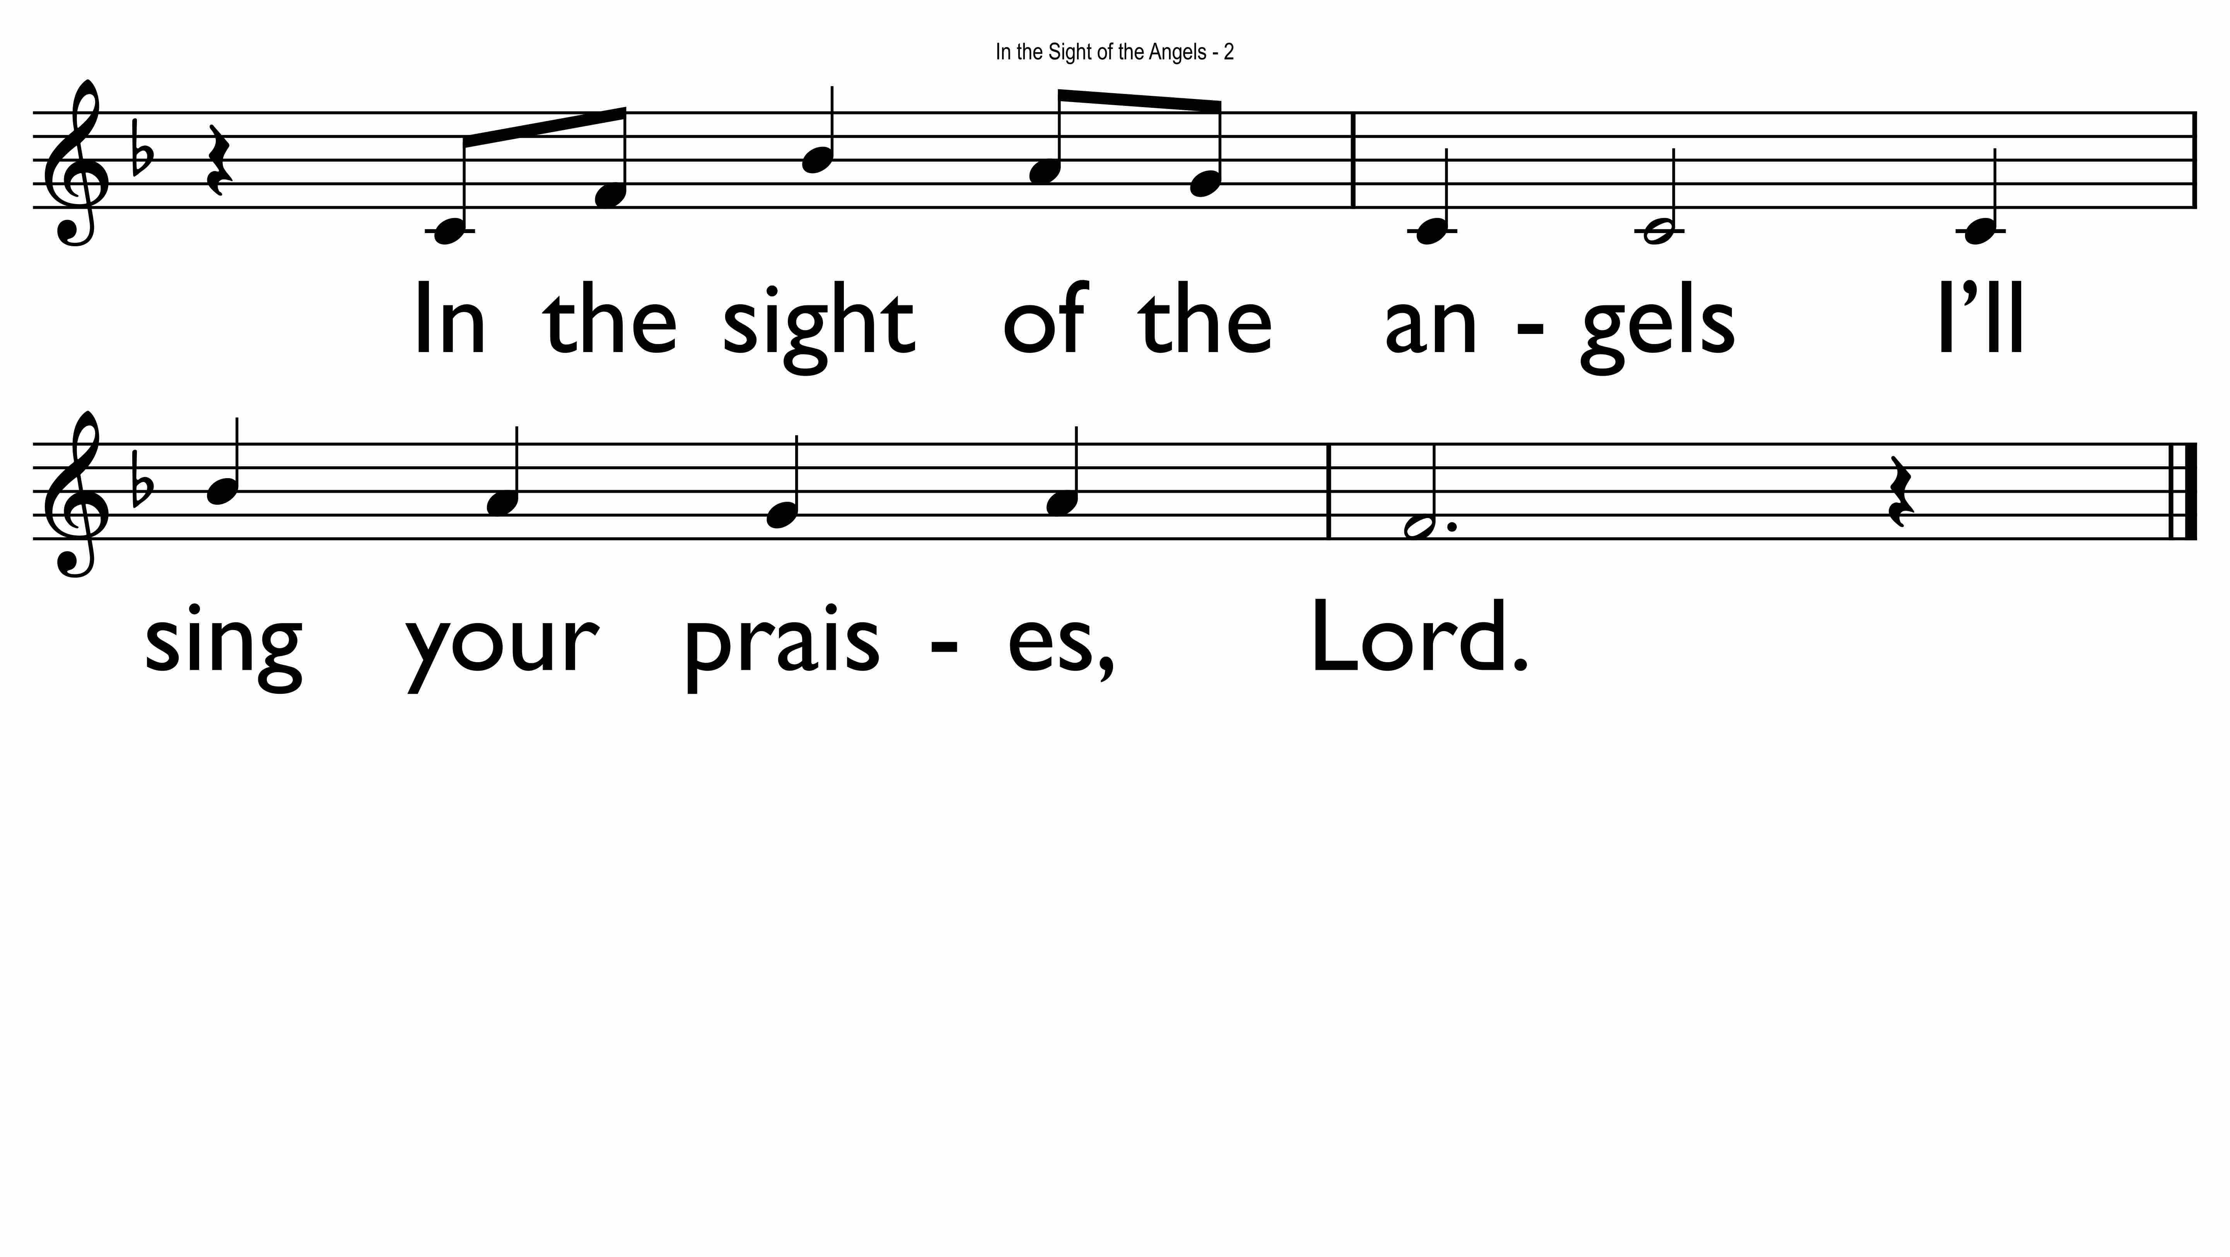

Slide 33
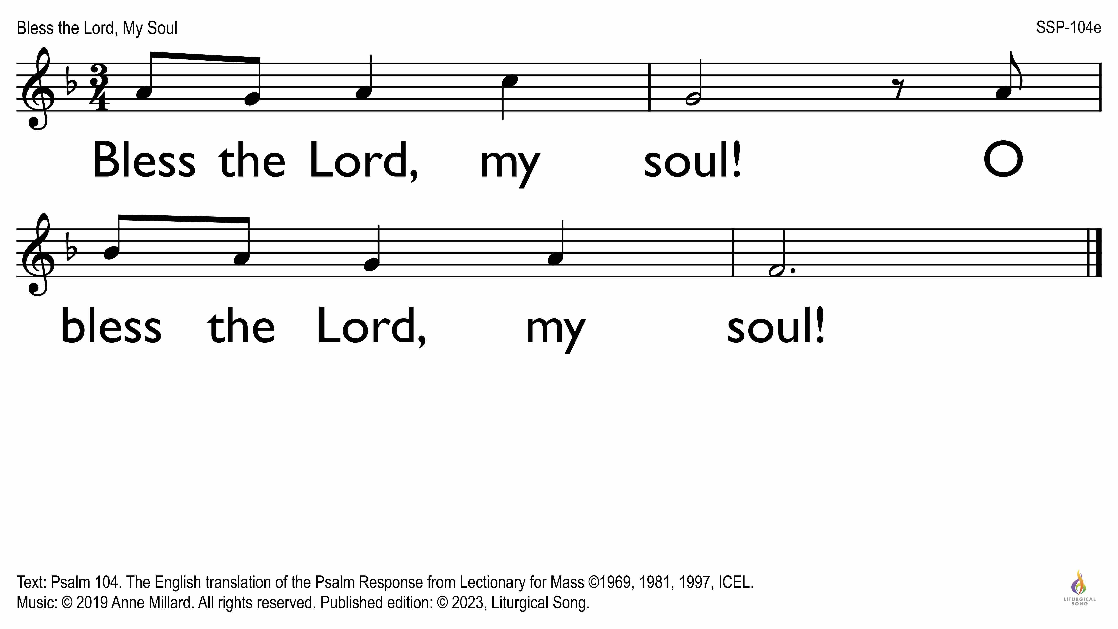

Slide 34
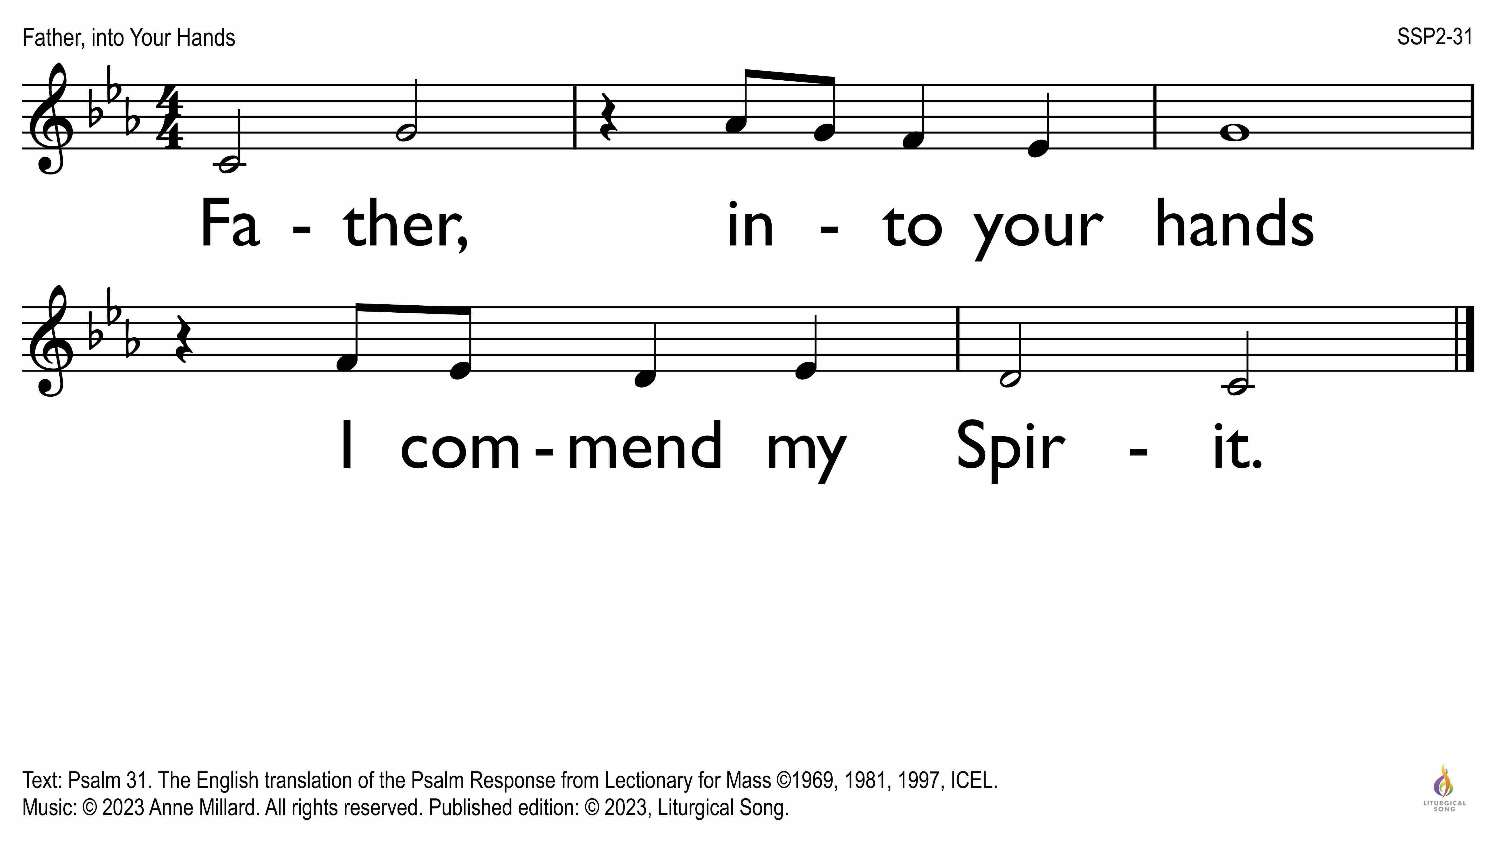

Slide 35
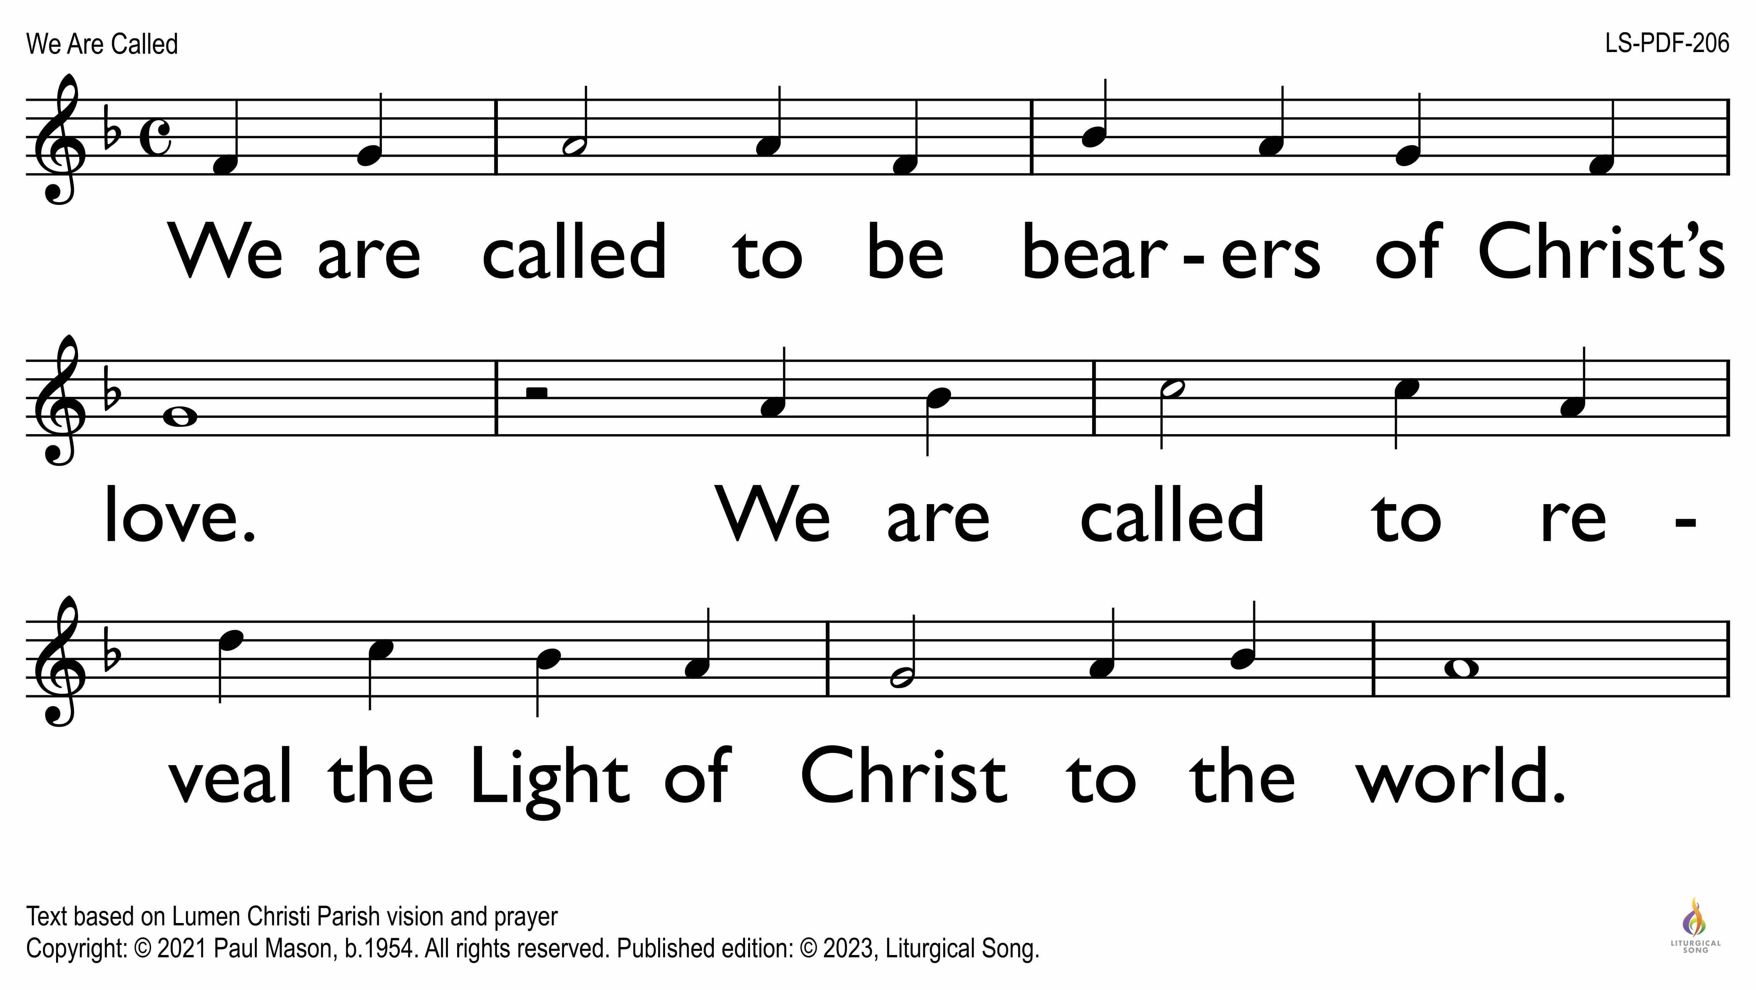

Slide 36
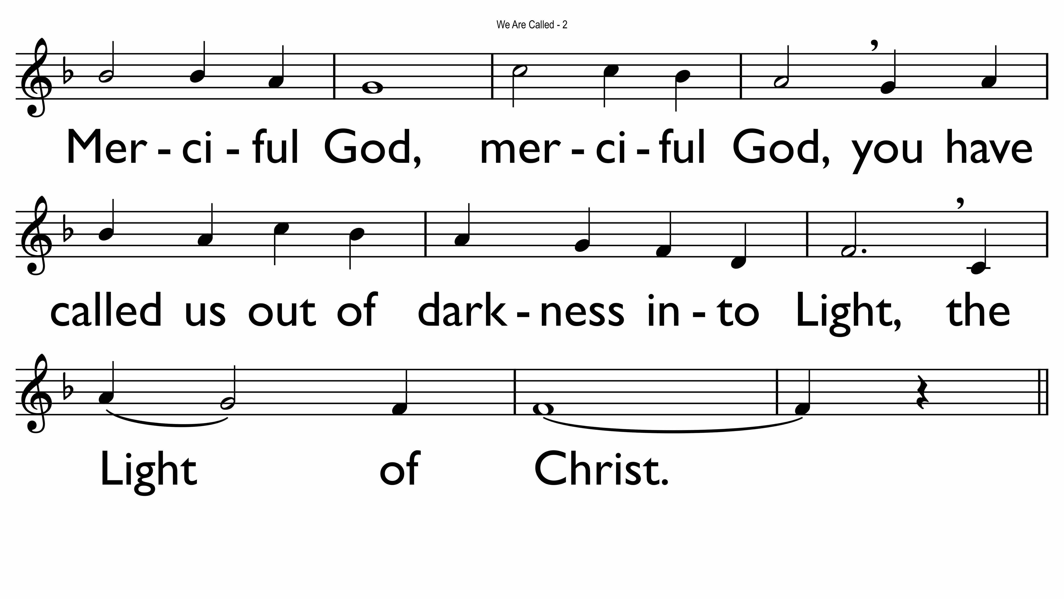

Slide 37
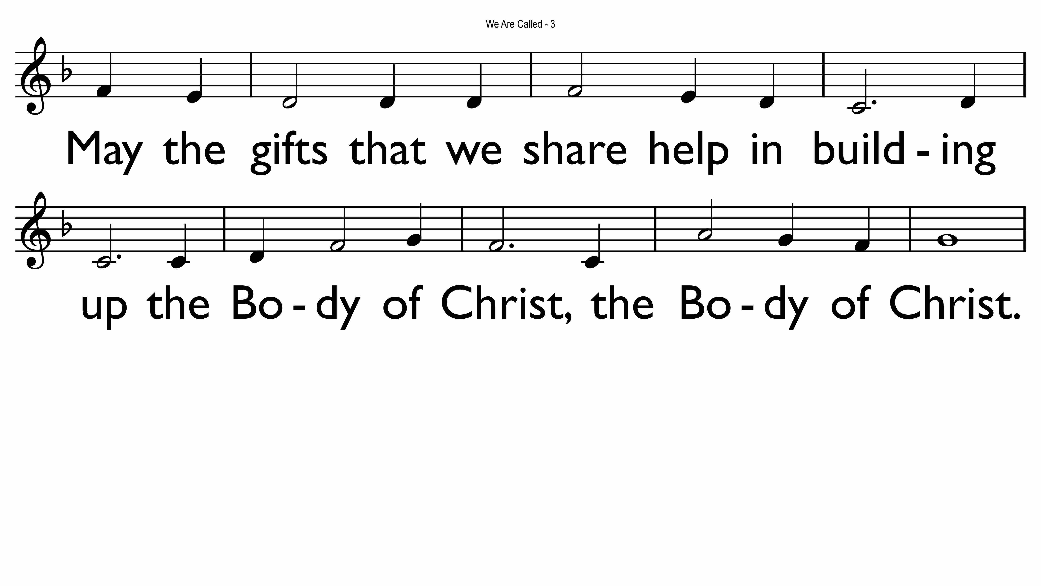

Slide 38
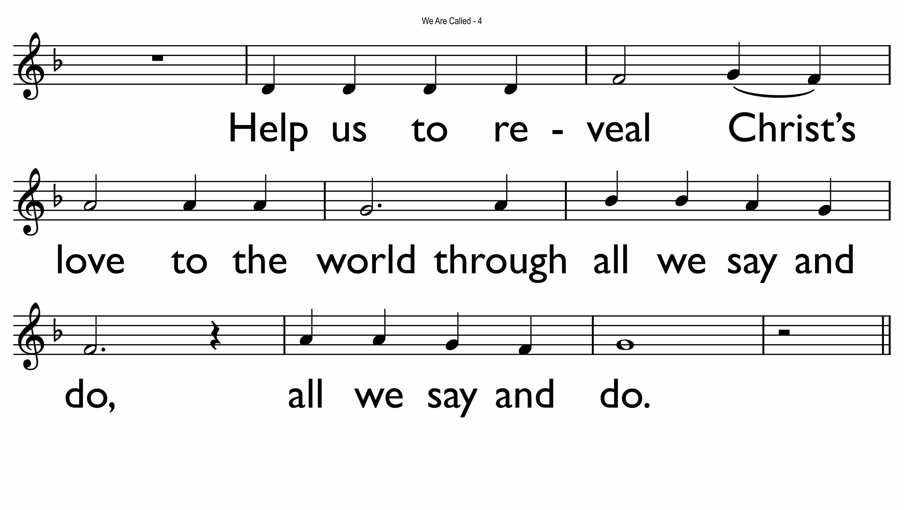

Slide 39
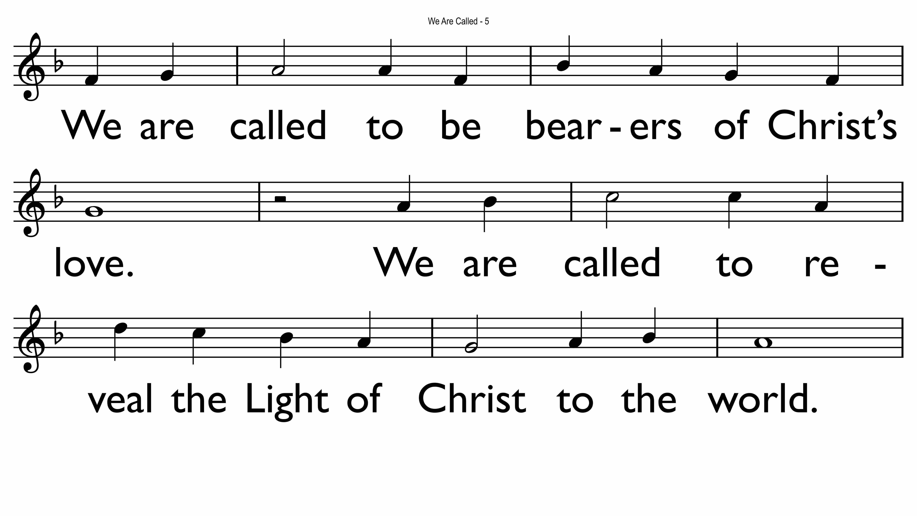

Slide 40


Slide 41
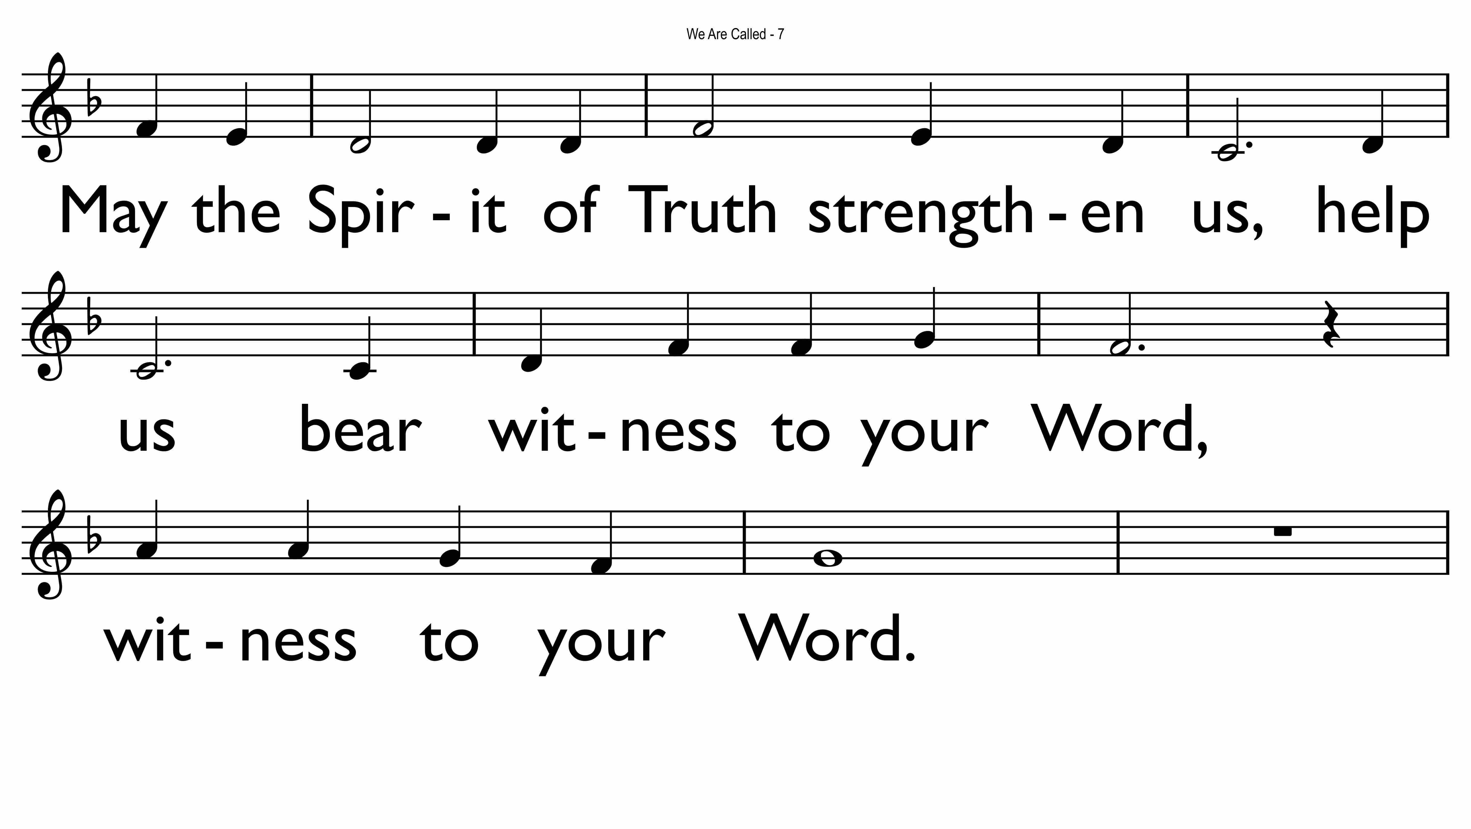

Slide 42
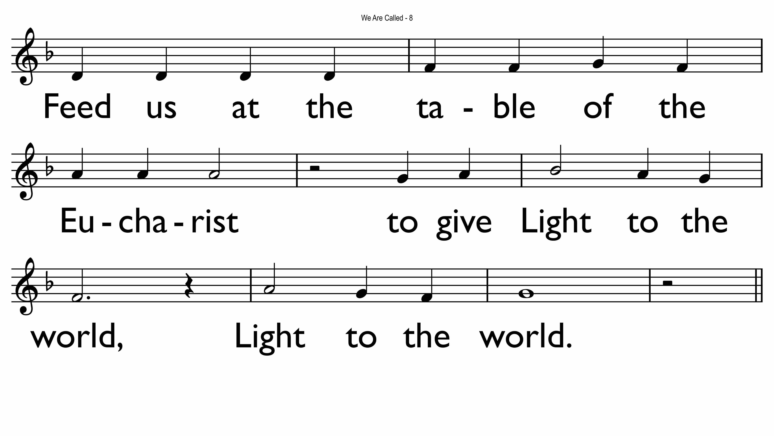

Slide 43


Slide 44
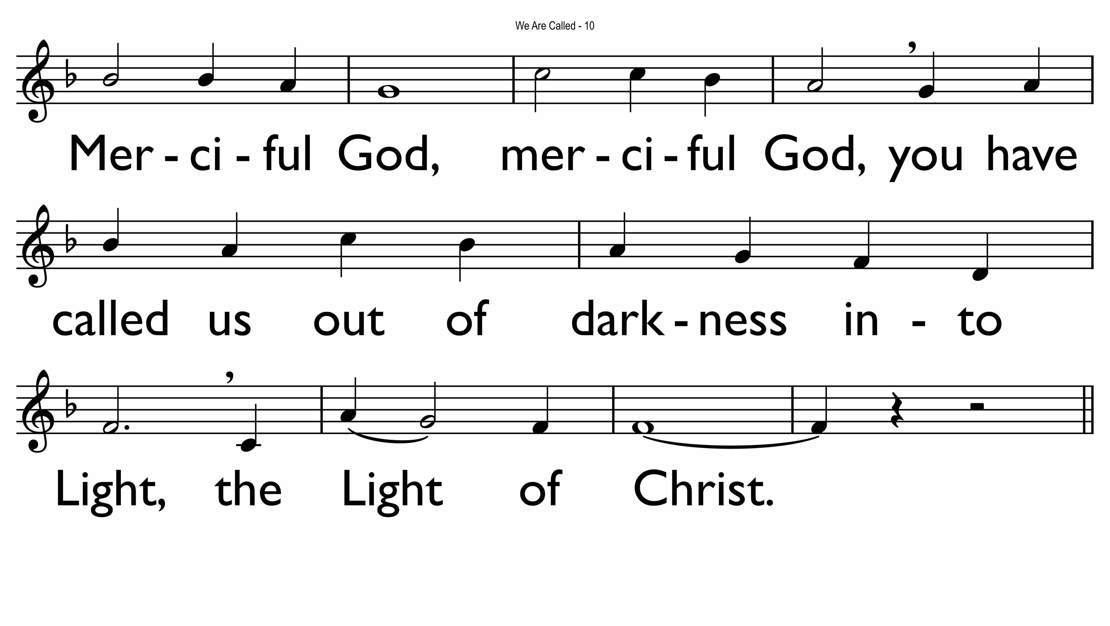

Slide 45
Acknowledgements
Composers
  Fiona Dyball
  Roger Heagney
  Paul Mason
  Anne Millard
Booth Sales
  Julie Moran
Performers
  Fiona Dyball, Soprano
  Cath Mahony, Soprano
  Paul Mason, Piano, Tenor
  Anne Field, Alto
  Toloa Mataele, Baritone
  Daniel Nguyen, Flute
  Tammy Stone, Soprano
  Damian Whelan, Piano and Organ

